Slide 1
Modeling of Production and Logistics Systems
Exercises
Jan Fábry
1/22/2022

Slide 2
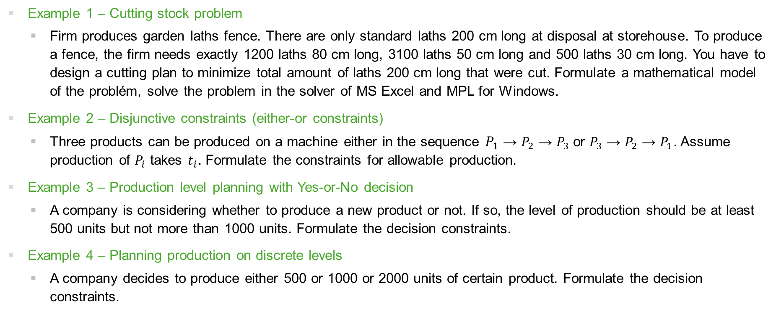
Examples for MPLS exercises
Repetition of linear and integer programming
Example 1 – Cutting stock problem
  Firm produces garden laths fence. There are only standard laths 200 cm long at disposal at storehouse. To produce a fence, the firm needs exactly 1200 laths 80 cm long, 3100 laths 50 cm long and 500 laths 30 cm long. You have to design a cutting plan to minimize total amount of laths 200 cm long that were cut. Formulate a mathematical model of the problém, solve the problem in the solver of MS Excel and MPL for Windows.
Example 2 – Disjunctive constraints (either-or constraints)
  Three products can be produced on a machine either in the sequence $P_{1}$ → $P_{2}$ → $P_{3}$or $P_{3}$ → $P_{2}$ → $P_{1}$. Assume production of $P_{i}$ takes $t_{i}$. Formulate the constraints for allowable production.
Example 3 – Production level planning with Yes-or-No decision
  A company is considering whether to produce a new product or not. If so, the level of production should be at least 500 units but not more than 1000 units. Formulate the decision constraints.
Example 4 – Planning production on discrete levels
  A company decides to produce either 500 or 1000 or 2000 units of certain product. Formulate the decision constraints.

Slide 3

Examples for MPLS exercises
Repetition of linear and integer programming
Example 5 – Disjunctive variables (k out of n variables must be positive)
  A company is able to produce $n$ types of products. It is considering to produce only $k$ of them. For each product $i$, maximal production level$q_{i}$ is given. Formulate the decision constraints.
Example 6 – Bottleneck assignment problem
  The project consists of 5 independent parts. In the company 5 departments can manage the parts individually. Historical data shows average times (in days) departments finished
  similar tasks (see the table). N.A. represents the fact a department did not work
  on such task in the past. The company wants to finish
  the whole project as soon as possible. Formulate
  a mathematical model of the problem and solve
  the problem in the solver of MS Excel and
  MPL for Windows
Time | Part1 | Part2 | Part3 | Part4 | Part5
Dept1 | 25 | 15 | N.A. | 17 | 25
Dept2 | 22 | N.A. | 22 | 20 | 22
Dept3 | 20 | 18 | 25 | 16 | 23
Dept4 | N.A. | 20 | 30 | 21 | 28
Dept5 | 27 | 19 | 27 | 18 | N.A.

Slide 4
Examples for MPLS exercises
Product designing
Example 7 – Collaborative designing
  The following table shows the information flows between designers providing different activities (A, B, C, D, E) in product designing.
  Construct a cooperation graph corresponding to all information flows.
  Identify groups of interconnected activities (calculate the strong relation matrix and construct the corresponding graph with the components of the strong relation).
 | A | B | C | D | E
A | 0 | 1 | 1 | 0 | 0
B | 1 | 0 | 1 | 1 | 0
C | 0 | 0 | 0 | 1 | 0
D | 0 | 0 | 0 | 0 | 1
E | 0 | 0 | 1 | 0 | 0

Slide 5
Examples for MPLS exercises
Placement of facilities
Example 8 – Break-even point analysis
  A company considers placement of facility. There are three locations at disposal – A, B and C. The following table shows fixed costs FC and variable costsVC connected with the production quantity q on facility in a location.
  Decide where the facility will be placed at a production quantity of 600 units.
  If you do not know the production quantity, determine the interval over which the production volume must vary for the location to be optimal in terms of total cost.
Location | FC | VC
A | 200 | 15q
B | 300 | 10q
C | 170 | 20q

Slide 6
Examples for MPLS exercises
Placement of facilities
Example 9 – Multiple criteria evaluation of alternatives
  The company wants to expand its business to another country. It is considering building a new facility in one of three countries (A, B, C). It evaluates each location according to the availability of materials, transport, climate and the level of taxes, with importance expressed as weights of 0.3, 0.4, 0.1 and 0.2. The table shows the evaluation on a scale of 0 to 100 of the options considered under each criterion. Decide in which country the new facility will be located. Use the Weighted sum approach.
Location | Material | Transport | Climate | Taxes
A | 90 | 35 | 40 | 60
B | 40 | 80 | 50 | 70
C | 50 | 10 | 85 | 50

Slide 7
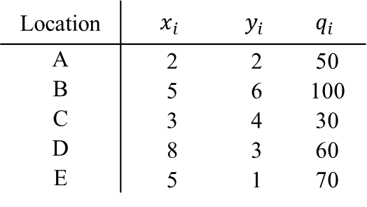
Examples for MPLS exercises
Placement of facilities
Example 10 – Method of gravity center
  The company is deciding where to locate the facility, whose output will be distributed to five customers. The following table shows the coordinates of the customers and the goods quantity to be received. Find the optimal location (coordinates) of the new facility using both the simple and weighted center of gravity methods.
Location | $$x_{i}$$ | $$y_{i}$$ | $$q_{i}$$
A | 2 | 2 | 50
B | 5 | 6 | 100
C | 3 | 4 | 30
D | 8 | 3 | 60
E | 5 | 1 | 70

Slide 8
Examples for MPLS exercises
Placement of facilities
Example 11 – Facility location problem (modified transportation problem)
  The company currently has two warehouses (S1 and S2). The capacity of these warehouses is no longer sufficient to cover deliveries from two sources (D1 and D2). The company therefore needs to build another warehouse. The decision is between locations A and B, where the criterion under consideration is the total cost of transporting supplies from both sources. The unit transport costs (in thousands of CZK per tonne), the monthly warehouse capacities and required delivery quantities (both in tonnes) are given in the table below.
  Find the optimal delivery for both options separately and decide which warehouse will be selected.
  Formulate one mathematical model that considers both options simultaneously and finds the optimal delivery (only one of warehouses A and B can be selected).
  How would the optimal solution change if the company rents warehouses A and B for monthly payments of 150 and 100 thousands of CZK?
 | S1 | S2 | A | B | a_{i}
D1 | 5 | 6 | 3 | 4 | 100
D2 | 4 | 3 | 7 | 6 | 100
b_{j} | 90 | 70 | (40) | (40)

Slide 9
Examples for MPLS exercises
Placement of facilities
Example 12 – Facility location problem (quadratic assignment problem)
  The company intends to establish 5 warehouses in 5 cities. In the first table, distances (in km) between cities are given. The second table shows a number of necessary travels between warehouses within 1 month. The objective is to allocate the warehouses minimizing total travelling cost.
Distance | City1 | City2 | City3 | City4 | City5
City1 | 0 | 50 | 60 | 130 | 100
City2 | 50 | 0 | 70 | 150 | 120
City3 | 60 | 70 | 0 | 80 | 40
City4 | 130 | 150 | 80 | 0 | 50
City5 | 100 | 120 | 40 | 50 | 0
Travels | WH1 | WH2 | WH3 | WH4 | WH5
WH1 | 0 | 10 | 15 | 12 | 8
WH2 | 9 | 0 | 18 | 16 | 10
WH3 | 20 | 8 | 0 | 10 | 12
WH4 | 10 | 15 | 11 | 0 | 22
WH5 | 17 | 12 | 9 | 11 | 0

Slide 10
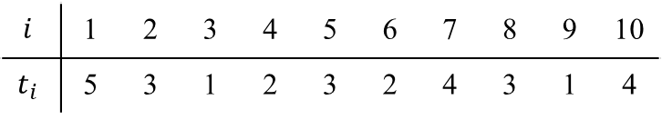
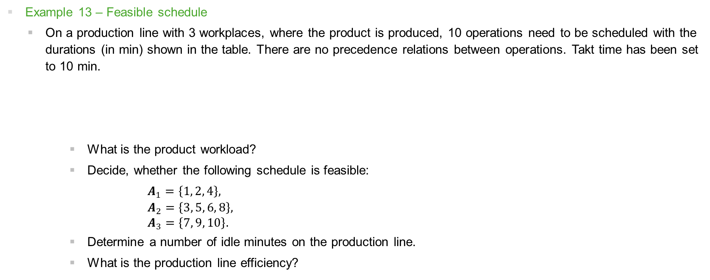
Examples for MPLS exercises
Product schedule
Example 13 – Feasible schedule
  On a production line with 3 workplaces, where the product is produced, 10 operations need to be scheduled with the durations (in min) shown in the table. There are no precedence relations between operations. Takt time has been set to 10 min.
  What is the product workload?
  Decide, whether the following schedule is feasible:
  $A_{1}=\left\{1, 2, 4\right\},$
$$A_{2}=\left\{3, 5, 6, 8\right\}, \\ A_{3}=\left\{7, 9, 10\right\}.$$
  Determine a number of idle minutes on the production line.
  What is the production line efficiency?
$$i$$ | 1 | 2 | 3 | 4 | 5 | 6 | 7 | 8 | 9 | 10
$$t_{i}$$ | 5 | 3 | 1 | 2 | 3 | 2 | 4 | 3 | 1 | 4

Slide 11
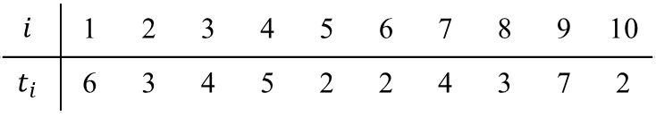
Examples for MPLS exercises
Product schedule
Example 14 – Minimization of a number of workplaces
  The company wants to schedule a product on the line, the production consists of 10 operations with durations (in min) given in the table(in min. There are no technological interdependencies between the operations,
  i.e. no precedence relation is defined. The takt time is set to 10 min.
  What is a product workload?
  Determine minimal and maximal number of workplaces on production line and find any feasible schedule.
  For found schedule, determine a number of idle minutes on the whole production line and calculate its efficiency.
$$i$$ | 1 | 2 | 3 | 4 | 5 | 6 | 7 | 8 | 9 | 10
$$t_{i}$$ | 6 | 3 | 4 | 5 | 2 | 2 | 4 | 3 | 7 | 2

Slide 12
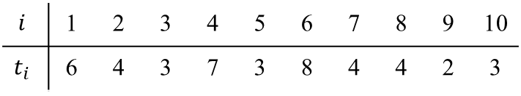
Examples for MPLS exercises
Product schedule
Example 15 – Minimization of takt time
  The company wants to schedule a product with 10 operations on 5 workplaces. Their durations (in min) are given in the table. There is no precedence relation between the operations.
  What is the theoretically achievable minimum takt time?
  Find the minimal value of takt time.
  What is the production line efficiency?
$$i$$ | 1 | 2 | 3 | 4 | 5 | 6 | 7 | 8 | 9 | 10
$$t_{i}$$ | 6 | 4 | 3 | 7 | 3 | 8 | 4 | 4 | 2 | 3

Slide 13
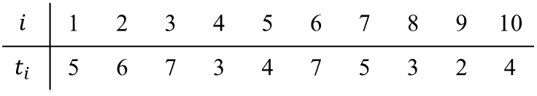
Examples for MPLS exercises
Product schedule
Example 16 – Determination of takt time for required daily production size
  The company plans to achieve the daily production size 𝑄=50 units in the working period of length 𝑇=8 hours. Production of the product consists of 10 operations with durations (in min) given in the table.
  What is the highest possible takt time at which the desired daily production can still be achieved?
  Is it possible to find a feasible schedule for this takt time with the existing 6 workplaces? What will be the efficiency of the whole production line?
  What can be the minimum takt time without increasing the number of workplaces? What is the efficiency of the line in this case?
$$i$$ | 1 | 2 | 3 | 4 | 5 | 6 | 7 | 8 | 9 | 10
$$t_{i}$$ | 5 | 6 | 7 | 3 | 4 | 7 | 5 | 3 | 2 | 4

Slide 14
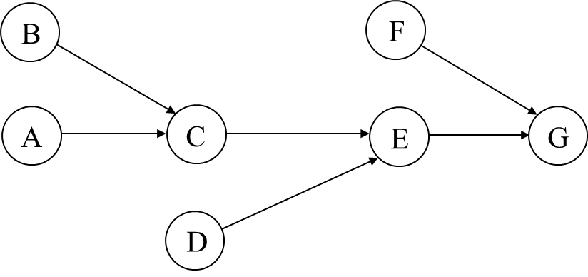
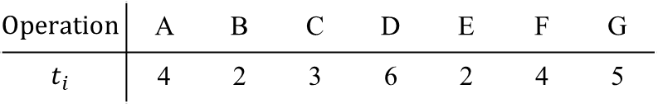
Examples for MPLS exercises
Product schedule
Example 17 – Heuristic methods for scheduling operations
  The company plans to produce 50 units of product per day, which production consists of 7 operations. All precedence relations for them are illustrated by the directed graph in the figure. In the table, the durations of operations are given. The length of the daily working period is 8 hours. Schedule all operations on workplaces using all 4 heuristics.
$$Operation$$ | A | B | C | D | E | F | G
$$t_{i}$$ | 4 | 2 | 3 | 6 | 2 | 4 | 5

Slide 15
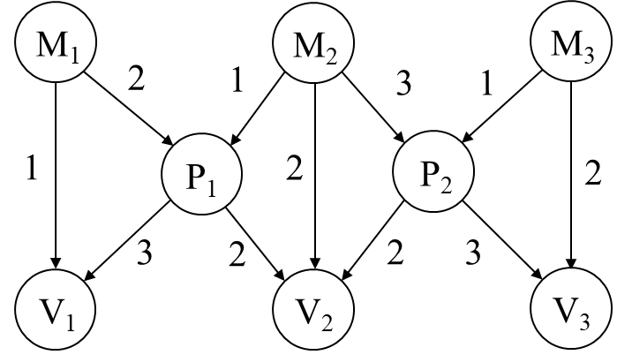
Examples for MPLS exercises
Production planning
Example 18 – Multi-level planning
  The company produces three final products V₁, V₂ and V₃ in 40, 20 and 30 units. Three types of materials M₁, M₂, M₃ and two semi-finished products P₁ and P₂ are used. Product structure is expressed by Gozinto graph. Calculate all production input and output values:
  Use the Leontief model.
  Use the optimization model.

Slide 16
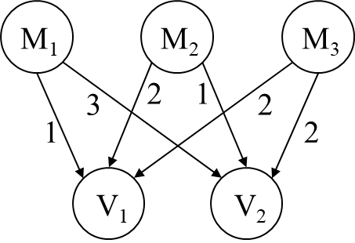
Examples for MPLS exercises
Production planning
Example 19 – Multi-level planning (MRP)
  For 1 unit of product V₁, 1 unit of material M₁, 2 units of material M₂ and 2 units of material M₃ are required. For the production of 1 unit of product V₂, 3 units of material M₁, 1 unit of material M₂ and 2 units of material M₃ (see the figure). The table shows the initial inventory level of materials and final products. There are their delivery times given in weeks. Products can be produced as soon as all the material for them is available. The company has to deliver 250 units of product V₁ in 7th week and 180 units of product V₂ in 8th week, and 200 units od product V₁ and 160 units of product V₂ in 17th week. The objective is to plan the material requirements for the whole period
  so that the demand for both products is met.
Item | Initial inventory | Delivery time
M₁ | 20 | 1
M₂ | 60 | 2
M₃ | 60 | 2
V₁ | 100 | 1
V₂ | 120 | 2

Slide 17
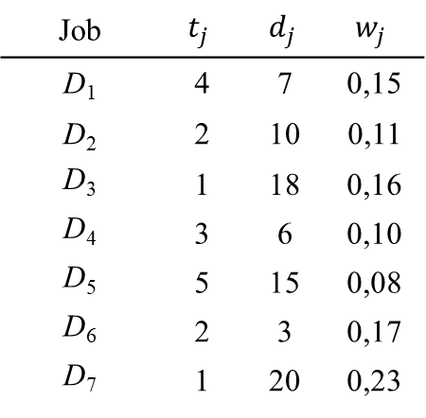

Examples for MPLS exercises
Production scheduling
Example 20 – Models $1||F_{max}$and $1||F_{max}(w)$
  Consider 7 jobs, for which you know their processing time (in hours), their due time (in hour) and their relative importance in terms of weight (see table). The ready times for all jobs are zero.
  Find the optimal schedule for model $1||F_{max}$. Determine the total tardiness of all jobs.
  Try to find the optimal schedule that would meet the due times of all jobs.
  Find the optimal schedule for model $1||F_{max}\left(w\right)$.
Job | $$t_{j}$$ | $$d_{j}$$ | $$w_{j}$$
D₁ | 4 | 7 | 0,15
D₂ | 2 | 10 | 0,11
D₃ | 1 | 18 | 0,16
D₄ | 3 | 6 | 0,10
D₅ | 5 | 15 | 0,08
D₆ | 2 | 3 | 0,17
D₇ | 1 | 20 | 0,23

Slide 18
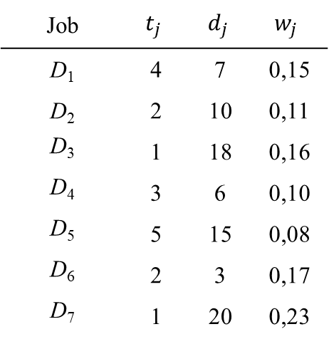

Examples for MPLS exercises
Production scheduling
Example 21 – Models M$1||\overline{F}$ and $1||\overline{F}(w)$
  Find the optimal schedule for model $1||\overline{F}$.
  Find the optimal schedule for model $1||\overline{F}(w)$.
Job | $$t_{j}$$ | $$d_{j}$$ | $$w_{j}$$
D₁ | 4 | 7 | 0,15
D₂ | 2 | 10 | 0,11
D₃ | 1 | 18 | 0,16
D₄ | 3 | 6 | 0,10
D₅ | 5 | 15 | 0,08
D₆ | 2 | 3 | 0,17
D₇ | 1 | 20 | 0,23

Slide 19
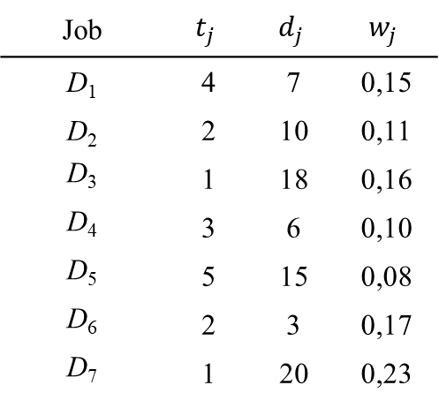

Examples for MPLS exercises
Production scheduling
Example 22 – Models $1||L_{max}$, $1||T_{max}$, $1||L_{max}\left(w\right)$ and $1||T_{max}(w)$
  Find the optimal schedule for model $1||L_{max}$ ($1||L_{max}$). Determine the total tardiness of all jobs.
  Find the optimal schedule for model $1||T_{max}\left(w\right)$ using Lawler‘s algorithm.
Job | $$t_{j}$$ | $$d_{j}$$ | $$w_{j}$$
D₁ | 4 | 7 | 0,15
D₂ | 2 | 10 | 0,11
D₃ | 1 | 18 | 0,16
D₄ | 3 | 6 | 0,10
D₅ | 5 | 15 | 0,08
D₆ | 2 | 3 | 0,17
D₇ | 1 | 20 | 0,23

Slide 20
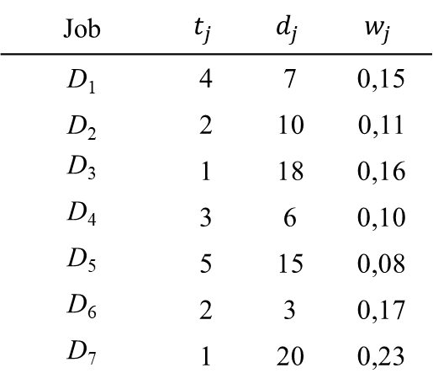

Examples for MPLS exercises
Production scheduling
Example 23 – Models $1||\overline{L}$ and $1||\overline{L}(w)$
  Find the optimal schedule for model $1||\overline{L}$.
  Find the optimal schedule for model $1||\overline{L}(w)$.
Job | $$t_{j}$$ | $$d_{j}$$ | $$w_{j}$$
D₁ | 4 | 7 | 0,15
D₂ | 2 | 10 | 0,11
D₃ | 1 | 18 | 0,16
D₄ | 3 | 6 | 0,10
D₅ | 5 | 15 | 0,08
D₆ | 2 | 3 | 0,17
D₇ | 1 | 20 | 0,23

Slide 21
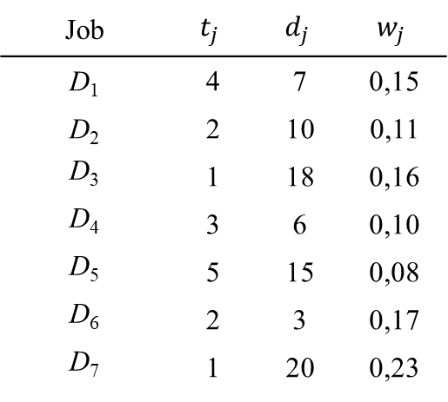

Examples for MPLS exercises
Production scheduling
Example 24 – Model $1||N$
  Find the optimal schedule for model $1||N$ using Moore‘s algorithm.
Job | $$t_{j}$$ | $$d_{j}$$ | $$w_{j}$$
D₁ | 4 | 7 | 0,15
D₂ | 2 | 10 | 0,11
D₃ | 1 | 18 | 0,16
D₄ | 3 | 6 | 0,10
D₅ | 5 | 15 | 0,08
D₆ | 2 | 3 | 0,17
D₇ | 1 | 20 | 0,23

Slide 22
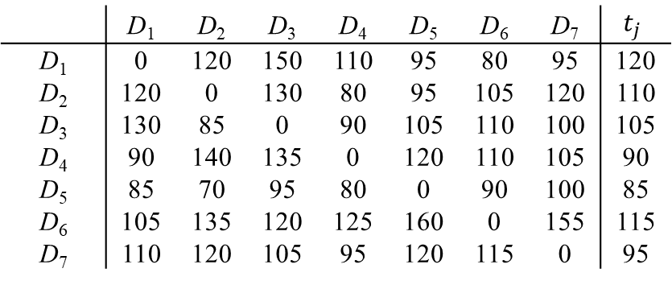

Examples for MPLS exercises
Production scheduling
Example 25 – Model $1|s_{jk}|C_{max}$
  The company wants to schedule 7 jobs on 1 machine so that they are completed in minimum time. The table shows the job processing times and the setup times between jobs (all values are in minutes).
  Find a schedule using the nearest neighbor algorithm for the travelling salesman problem.
  Find the optimal schedule using the mathematical model for the travelling salesman problem.
 | D₁ | D₂ | D₃ | D₄ | D₅ | D₆ | D₇ | $$t_{j}$$
D₁ | 0 | 120 | 150 | 110 | 95 | 80 | 95 | 120
D₂ | 120 | 0 | 130 | 80 | 95 | 105 | 120 | 110
D₃ | 130 | 85 | 0 | 90 | 105 | 110 | 100 | 105
D₄ | 90 | 140 | 135 | 0 | 120 | 110 | 105 | 90
D₅ | 85 | 70 | 95 | 80 | 0 | 90 | 100 | 85
D₆ | 105 | 135 | 120 | 125 | 160 | 0 | 155 | 115
D₇ | 110 | 120 | 105 | 95 | 120 | 115 | 0 | 95

Slide 23
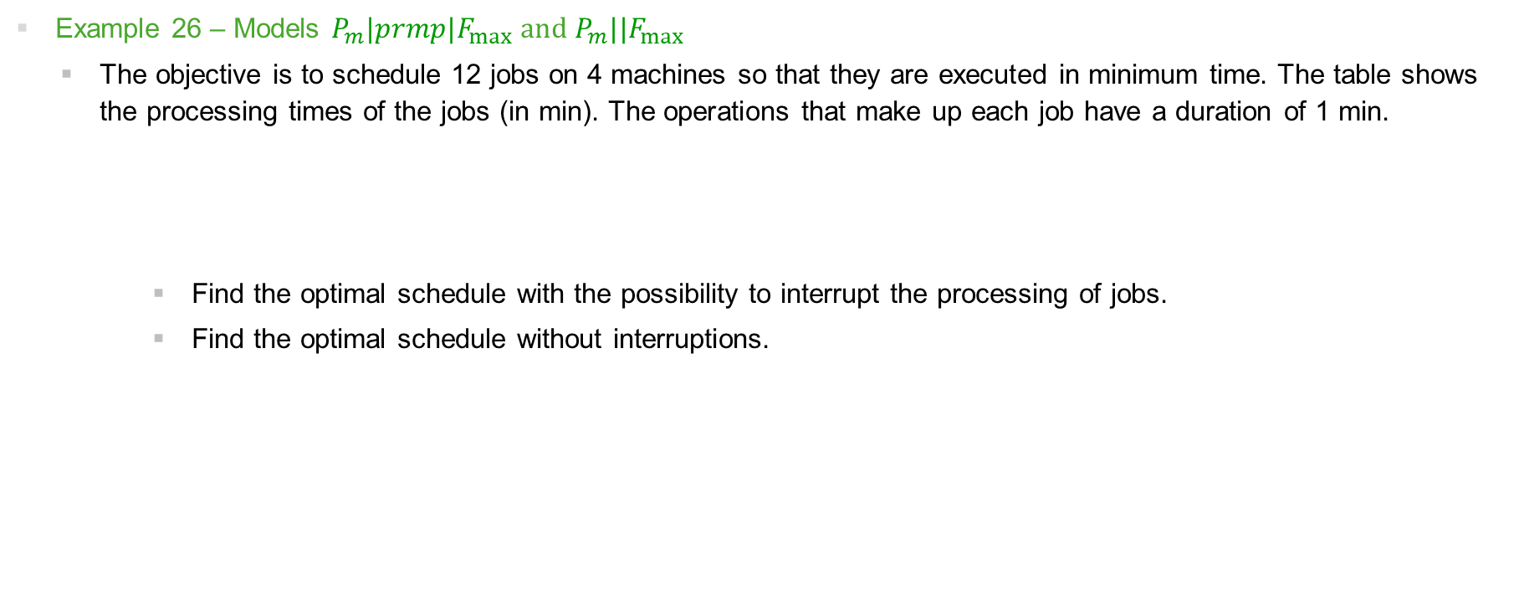
Examples for MPLS exercises
Production scheduling
Example 26 – Models $P_{m}|prmp|F_{max}$ and $P_{m}||F_{max}$
  The objective is to schedule 12 jobs on 4 machines so that they are executed in minimum time. The table shows the processing times of the jobs (in min). The operations that make up each job have a duration of 1 min.
  Find the optimal schedule with the possibility to interrupt the processing of jobs.
  Find the optimal schedule without interruptions.
 | D₁ | D₂ | D₃ | D₄ | D₅ | D₆ | D₇ | D₈ | D₉ | D₁₀ | D₁₁ | D₁₂
t_{j} | 3 | 5 | 2 | 4 | 8 | 6 | 5 | 5 | 4 | 3 | 7 | 3

Slide 24

Examples for MPLS exercises
Production scheduling
Example 27 – Model $P_{m}||\overline{F}$
  Find the optimal schedule without interruptions of processing of the jobs..
 | D₁ | D₂ | D₃ | D₄ | D₅ | D₆ | D₇ | D₈ | D₉ | D₁₀ | D₁₁ | D₁₂
t_{j} | 3 | 5 | 2 | 4 | 8 | 6 | 5 | 5 | 4 | 3 | 7 | 3

Slide 25

Examples for MPLS exercises
Production scheduling
Example 28 – Model $F_{m}||C_{max}$
  There are 10 jobs given, which must be scheduler to 2 serial machines. The table shows the processing times of the jobs (in min) on both machines. The objective is to minimize the completion time of all jobs.
 | D₁ | D₂ | D₃ | D₄ | D₅ | D₆ | D₇ | D₈ | D₉ | D₁₀
t_{1j} | 1 | 6 | 3 | 3 | 5 | 7 | 6 | 2 | 3 | 5
t_{2j} | 3 | 5 | 1 | 5 | 6 | 4 | 5 | 4 | 5 | 4

Slide 26
Examples for MPLS exercises
Počítačová simulace
Example 29 – Generation of the values of random variables
  Generate 1000 values of random variable 𝑋 with the uniform probability distribution on interval (100, 200) and make a graph of the frequencies of values at predefined intervals..

Slide 27
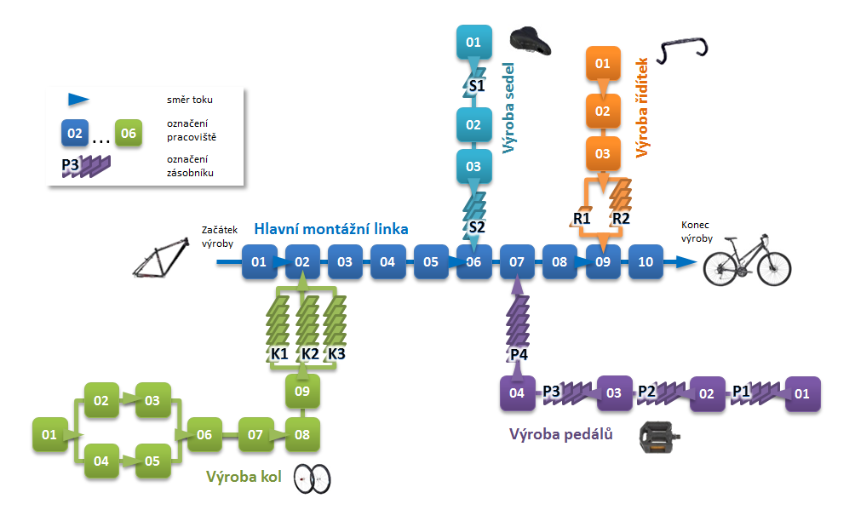
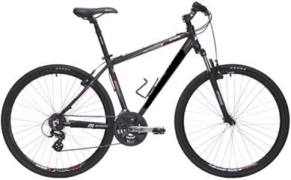
Examples for MPLS exercises
Počítačová simulace
Example 30 – Production of bicycles
  The production system consists of one main assembly line and four production sections (production of wheels, saddles, pedals and handlebars). The production sections are connected to the main assembly line by buffers. The FIFO principle is followed in them. The shift calendar is identical on all lines.
saddle
Flow
Workplace
Buffer
řídítka
Saddle production
Handlebar production
frame
handlebars
pedals
Beginning of production
Main assembly line
End of production
wheel
Pedal production
Wheel production

Slide 28
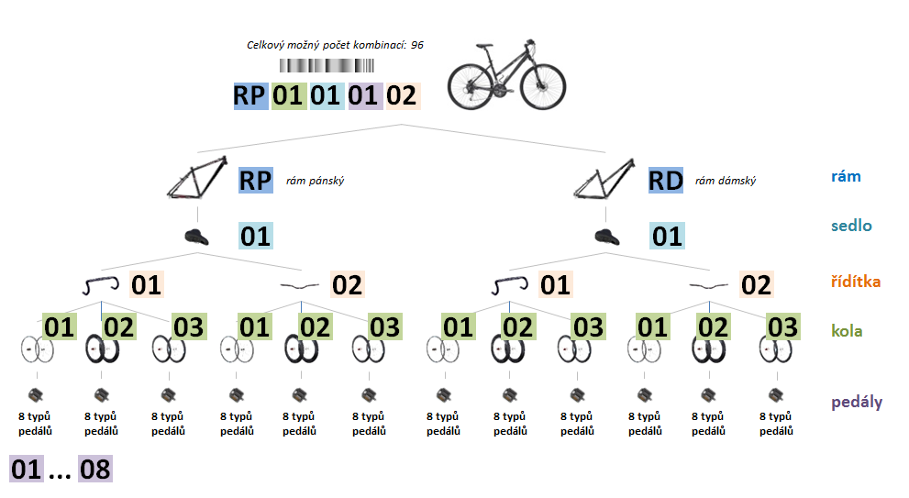
Examples for MPLS exercises
Počítačová simulace
Example 30 – Production of bicycles – continued
Total number of all possible combinations: 96
Men frame
Women frame
frames
saddled
handlebars
wheels
paddels

Slide 29
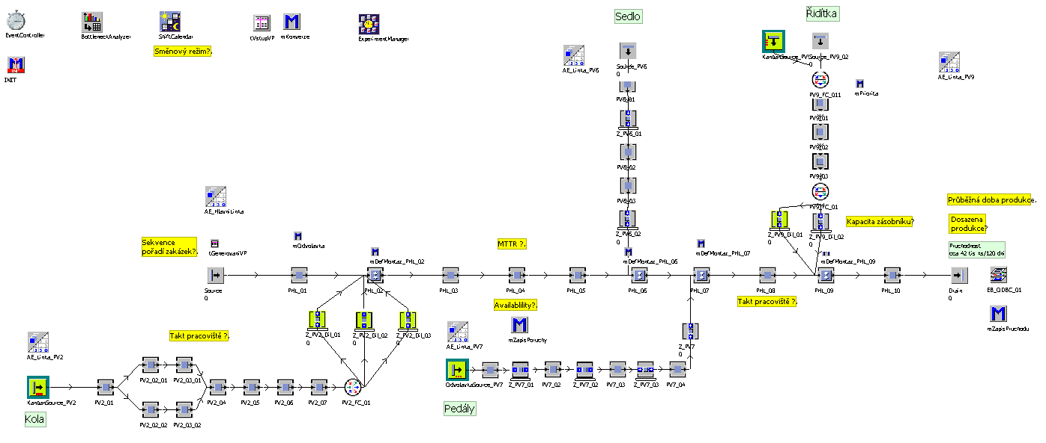
Examples for MPLS exercises
Počítačová simulace
Example 30 – Production of bicycles – continued

Slide 30
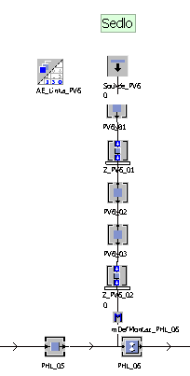
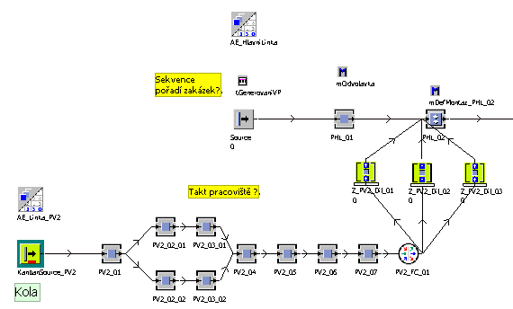
Examples for MPLS exercises
Počítačová simulace
Example 30 – Production of bicycles – continued

Slide 31
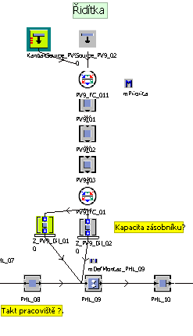
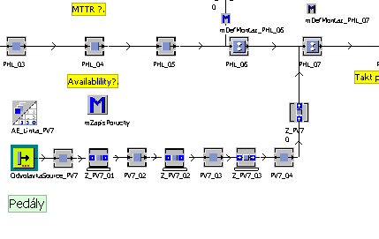
Examples for MPLS exercises
Počítačová simulace
Example 30 – Production of bicycles – continued

Slide 32
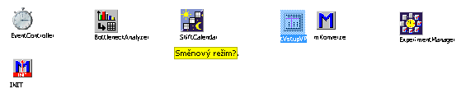
Examples for MPLS exercises
Počítačová simulace
Example 30 – Production of bicycles – continued

Slide 33
Examples for MPLS exercises
Počítačová simulace
Example 30 – Production of bicycles – continued
  Data analysis
  Mean of daily production quantity (sheet „10_Vystup“).
  Production program (sheet „01_Vstup“).
  Continuous workload time of the main line (sheets „01_Vstup“ and „10_Vystup“).
  Shift and pauses scheme (sheet „10_Vystup“).
  Capacity of buffer R2 (sheet „R2“).
  Takt time on workplace 03 of peddals production line (shett „Takt_03“).
  Takt time on workplace 08 of main assembly line (sheet „Takt_08“).
  Mean time ti repair (MTTR) on workplace 04 of main assembly line (shett „MTTR“).
  Availability of workplace 04 of main assembly line (sheets „MTTR“ and „10_Vystup“).

Slide 34


Thank you for attention
Jan Fábry
Department of Production, Logistics and Quality Management
fabry@savs.cz www.janfabry.cz

