Slide 1
Operational Research II
Lectures
Jan Fábry
03.03.2025

Slide 2
Literature
Basic
FÁBRY, J. Operational Research II for full-time and distance form of studies. Mladá Boleslav: ŠAU, 2025. 253 pp. (Draft).
FÁBRY, J. Operational Research I for full-time and distance form of studies. Mladá Boleslav: ŠAU, 2022. 150 pp. ISBN 978-80-7654-048-4.
Recommended
EISELT, H. and SANDBLOM, C. Operations Research.: A Model-Based Approach. 1st edition, Heidelberg: Springer, 2010. 446 pp. ISBN 978-3-642-10325-4.
HILLIER, F. S. and LIEBERMAN, G. J. Introduction to Operations Research. 11th edition, McGraw-Hill, 2021. 964 pp. ISBN 9781260575873.
BOUCHERIE, R. J., BRAAKSMA, A. and TIJMS, H. Operations Research: Introduction to Models and Methods. World Scientific, 2022. 499 pp. ISBN 9789811239342.
RARDIN, R. L. Optimization in Operations Research. 2nd edition, Pearson, 2018. 1144 pp. ISBN 978-93-530-6636-9.
Fábry, J. Management Science. University of Economics Prague, 2003. ISBN 80-245-0586–X (Available at https://janfabry.cz/Management-Science.pdf).

Slide 3
Contents
Introduction to Operational Research
Definition and History
Decision Making
Modeling Process
Classification of models
Production Planning Problems
Basic Production Planning Problem
Production Planning Problem with semi-finished products
Using logical variables in a mathematical model
Fixed-Cost Production Planning Problem
Production Planning with alternative product production sequences
Production Planning with special restrictions for the production level
Cutting Stock Problem
Assignment Problem
Linear Assignment Problem
Bottleneck Assignment Problem
Perfect Matching Problem
Knapsack Problem
Graph Modeling
Basic Terminology
Maximum Flow Problem
Minimum-Cost Flow Problem
Transshipment Problem
Minimal Spanning Tree
Transportation and Routing Problems
Transportation Problem
Container Transportation Problem
Bin Packing Problem
Minimal Path Problem
Traveling Salesman Problem
Treveling Salesman Problem in Production
Treveling Salesman Problem with Time Windows
Vehicle Routing Problem
Pickup and Delivery Problems
Chinese Postman Problem

Slide 4
Introduction to Operational Research
1

Slide 5
Introduction to Operational Research
Alternative Names and Related Fields
Operational / Operations Research (OR)
Management Science (MS)
Operations Analysis
Quantitative Analysis
Quantitative Methods
Systems Analysis
Decision Analysis
Decision Science
Computer Science

Slide 6
Introduction to Operational Research
Definition
OR is the application of scientific methods, techniques and tools to problems involving the operations of systems so as to provide those in control of the operations with optimum solutions to the problems.
MS/OR is the application of the scientific method to the study of the operations of large, complex organizations or activities.
MS/OR is the application of the scientific method to the analysis and solution of managerial decision problems.
Summary
Application of SCIENTIFIC METHOD.
Study of LARGE & COMPLEX SYSTEMS.
Analysis of MANAGERIAL PROBLEMS.
Finding OPTIMAL SOLUTION.
Use of MATHEMATICAL MODELS.
Use of COMPUTERS & SPECIAL SOFTWARE.

Slide 7
Introduction to Operational Research
Software
MPL for Windows
AMPL
Lingo (LINDO)
XPRESS (FICO)
CPLEX (IBM ILOG)
AIMMS
Gurobi
NEOS
MS Excel (FRONTLINE SOLVERS)
SIMPROCESS
SIMUL 8
Matlab

Slide 8
Introduction to Operational Research
Decision making
Two or more alternatives.
Conclusion = Decision.
Systematic process.
Evaluating the alternatives
Defining the problem
Selecting one alternative
Searching for alternative courses of action

Slide 9
Introduction to Operational Research
Modeling
Reality
Model
Finding a proper balance between the level of simplification of the model and the good representation of reality.

Slide 10
Introduction to Operational Research
Models
Deterministic – all parameters are known with certainty.
Probabilistic (stochastic) – some parameters are values of random variables.
Static – all data is known in advance (before solution process).
Dynamic – data can be changed after solution is obtained.

Slide 11
Introduction to Operational Research
Modeling Process (Analytical Approach)
Definition of the Problem
Formulation of the Conceptual Model
Real-World System
Formulation of the Mathematical Model
Results Interpretation
Model Verification
Model Validation
Sensitivity Analysis
Implementation
Solution of the Model

Slide 12
Introduction to Operational Research
Linear Programming
Conceptual model
Processes.
Restrictions.
Objective.
Mathematical model
Decision Variables – continuous, integral, binary.
Constraints – equations, inequalities.
Objective function – max, min.
Solution
Feasible – satisfies all constraints.
Optimal – best feasible solution in terms of the objective.
Infeasible – does not satisfy any constraint.

Slide 13
Introduction to Operational Research
Linear Programming
Solution
Results Interpretation – explanation of values to the others (e.g. client).
Model Verification – comparison of the mathematical model with the conceptual model.
Model Validation – comparison of results with the real expectations.
Sensitivity Analysis – examination of the impact of changes in inputs on outputs.
Implementation
Use of results in real system.
Special situations of LP problems
Unique optimal solution.
Multiple optimal solution.
No optimal solution.
No feasible solution.

Slide 14
Introduction to Operational Research
Linear Programming
Notation

Slide 15
Production Planning Problems
2

Slide 16
Production Planning Problems
Capacity Production Planning Problem
Example
The joinery manufactures tables and chairs. The production process includes machining, grinding and assembly.
The table components are machined in 5 hours, ground in 4 hours and assembled in 3 hours.
The chair components are machined in 2 hours, ground in 3 hours and assembled in 4 hours.
There are 270 hours available for machining, 250 hours for grinding and 200 hours for assembly.
The profit per table sold is €100 and per chair sold is €60.
The aim is to design the production so that the total profit from the furniture sold is as high as possible (we assume that all the production is sold).
How does the solution change if we have to produce 4 chairs for each table produced?

Slide 17
Production Planning Problems
Capacity Production Planning Problem – mathematical model formulation
Decision variables
Mathematical model
x₁ = number of tables produced,
x₂ = number of chairs produced.
Equivalent set of equations
Slack/surplus variables
$\text{(}\text{machining}$),
$$\text{(}\text{grinding}\text{)}\text{,}$$
$$\text{(}\text{assembly}\text{)}\text{,}$$
$$≤$$
$$≥$$
+ slack variable
- surplus variable

Slide 18
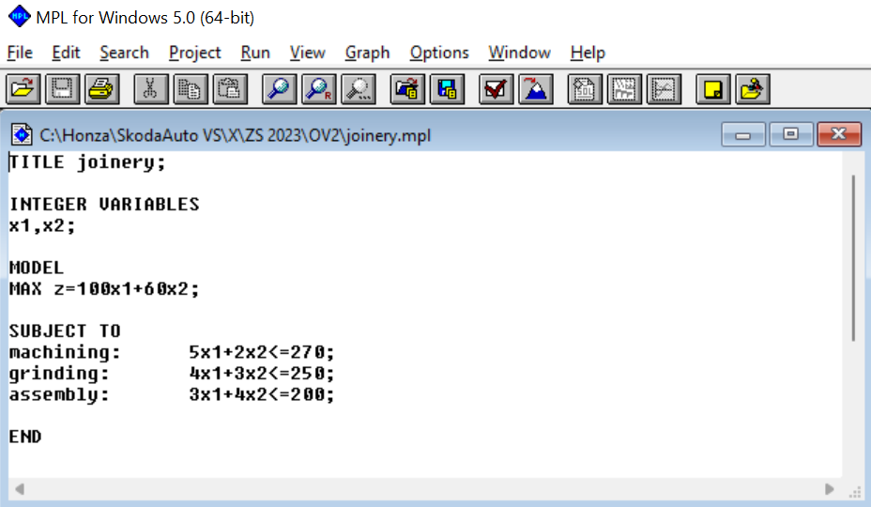
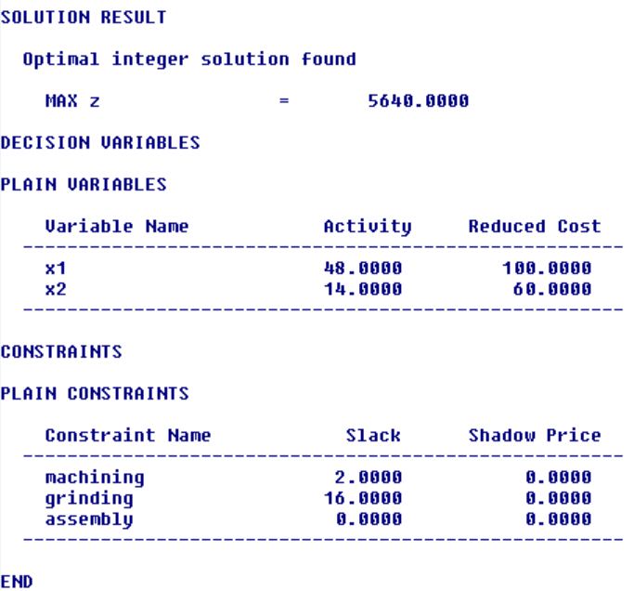
Production Planning Problems
Capacity Production Planning Problem – solution
Optimal solution
Decision variables
Objective value
Slack/surplus variables
$$x_{1}=48$$
$$x_{2}=14$$
$$z_{0}=5640$$
$$x_{3}=2$$
$$x_{4}=16$$
$$x_{5}=0$$

Slide 19
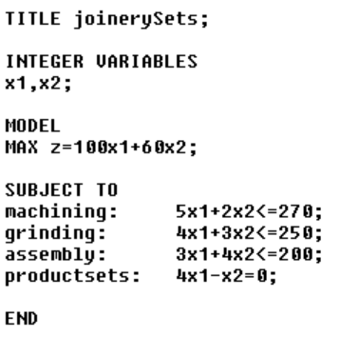
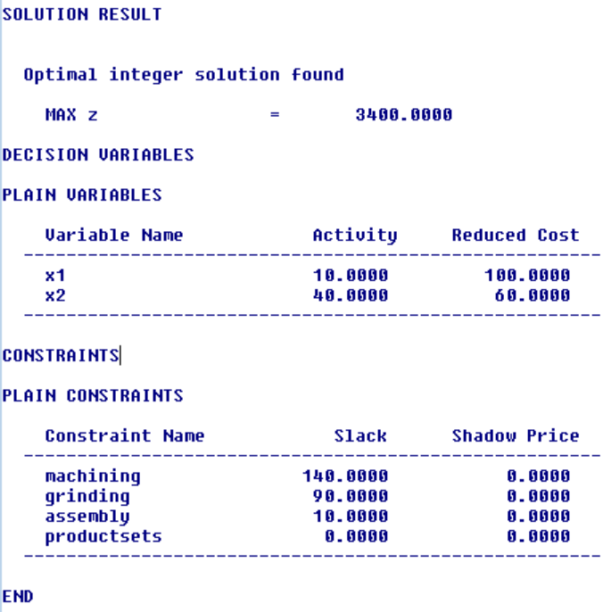
Production Planning Problems
Capacity Production Planning Problem – model, solution
Mathematical model
Additional limitation: How does the solution change if we have to produce 4 chairs for each table produced?
$\text{(}\text{sets}$)
Optimal solution
Decision variables
Objective value
Slack/surplus variables
$$x_{1}=10$$
$$x_{2}=40$$
$$z_{0}=3400$$
$x_{3}=$140
$$x_{4}=90$$
$$x_{5}=10$$

Slide 20
Production Planning Problems
Production Planning Problem with Semi-Finished Products
Example
Firm produces products P₁, P₂ a P₃.
To produce 1 unit of product P₁ the firm uses 3 kg of material.
To produce 1 unit of product P₂ the firm uses 2 kg of material and 1 unit of product P₁.
To produce 1 unit of product P₃ the firm uses 2 kg of material, 2 units of product P₁ and 1 unit of product P₂.
There are 1000 kg of material available.
Products P₁ and P₂ that are used as semi-finished products can also be sold themselves.
Prices of goods P₁, P₂ and P₃ are 5, 10 and 30 €. The objective is to maximize total revenue from products sold.

Slide 21
Production Planning Problems
Production Planning Problem with Semi-Finished Products
Assembly table
Entry | P₁ | P₂ | P₃
Material (kg) | 3 | 2 | 2
P₁ (unit) | - | 1 | 2
P₂ (unit) | - | - | 1
Price (€/unit) | 5 | 10 | 30

Slide 22
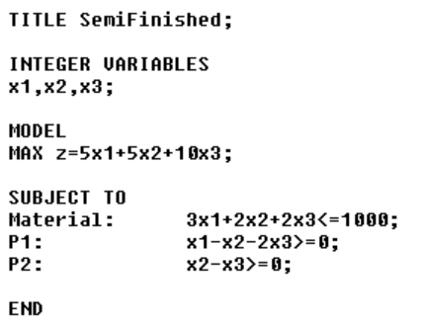
Production Planning Problems
Production Planning Problem with Semi-Finished Products – mathematical model formulation
Decision variables
Mathematical model

Slide 23
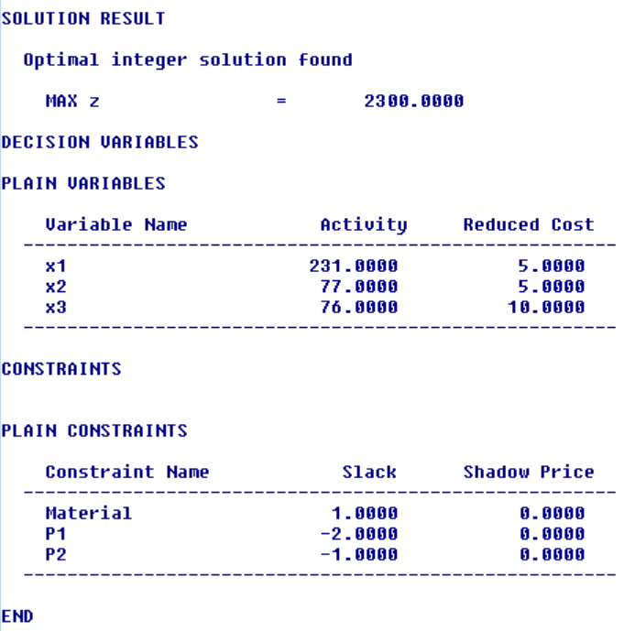
Production Planning Problems
Production Planning Problem with Semi-Finished Products – solution
Optimal solution
Decision variables
Objective value
Slack/surplus variables

Slide 24
Production Planning Problems
Using Logical Variables in a Mathematical Model
Binary decision variables
take the value 1 or 0,
they can be used in a mathematical model as logical or decision variables:
produced / not produced,
used/not used,
one option / another option,
etc.

Slide 25
Production Planning Problems
Fixed-Cost Production Planning Problem
Example
Possible production of n products on n production lines (each product on exactly one line - PL).
If the j-th product is produced, then a maximum of z_{j} pieces can be produced.
Fixed cost f_{j} has to be considered if PL_{j} is used (i.e. product i is produced).
Unit profit c_{j} is given for product j.
Standard production planning (capacity) constraints are defined.
The objective is to maximize total profit decreased by fixed cost.

Slide 26
Production Planning Problems
Fixed-Cost Production Planning Problem
Decision variables
Objective
Constraints

Slide 27
Production Planning Problems
Production Planning with Alternative Production Sequences
The problem is solved with the condition of validity of different sets of constraints (either-or constraints)
Example
Three products can be produced on a machine either in the sequence P₁ → P₂ → P₃ or P₃ → P₂ → P₁.
Assume production of P_{i} takes t_{i}.
Formulate the constraints for feasible production.

Slide 28
Production Planning Problems
Production Planning with Alternative Production Sequences
Decision variables
Model

Slide 29
Production Planning Problems
Production Planning with Range of Production Level
Example
A company is considering whether to produce a new product or not.
If so, the level of production should be at least 500 units but not more than 1000 units.
Decision variables
Model

Slide 30
Production Planning Problems
Planning Production on Discrete Levels
Example
A company decides to produce either 500 or 1000 or 2000 units of certain product.
Decision variables
Model

Slide 31
Production Planning Problems
Cutting Stock Problem
Input – raw product (dimension)
pipes, tubes (1D).
roles of paper or textile (1D or 2D),
wooden sticks or laths (1D),
wooden boards (1D or 2D),
steel plates (2D),
boxes (3D) – 3D rectangular packing problem.
Output – final or semi-finished products
Objective
minimization of total loss,
minimization of a number of raw products being cut,
maximization of number of final/assembled products,
maximization of revenue or profit ensuing from sold final/assembled products.

Slide 32
Production Planning Problems
Cutting Stock Problem
Table of cutting patterns
It contains all possibilities of cutting raw products.
Each cutting pattern corresponds to the variable giving a number of the raw products being cut according to this pattern.
Final products
Raw product
Cutting patterns
Loss

Slide 33
Production Planning Problems
Cutting Stock Problem
Example
Firm produces garden laths fence. To produce the fence for a particular order, the company needs 200 laths 140 cm long, 320 laths 80 cm long and 480 laths 60 cm long.
Only standard 300 cm long laths are available in the warehouse.
It is necessary to sytisfy the order while using the minimum number of standard laths.

Slide 34
Production Planning Problems
Cutting Stock Problem
Table of cutting patterns
Pattern | 1 | 2 | 3 | 4 | 5 | 6 | 7 | 8
140 cm (pcs) | 2 | 1 | 1 | 1 | 0 | 0 | 0 | 0
80 cm (pcs) | 0 | 2 | 1 | 0 | 3 | 2 | 1 | 0
60 cm (psc) | 0 | 0 | 1 | 2 | 1 | 2 | 3 | 5
Loss (in cm) | 20 | 0 | 20 | 40 | 0 | 20 | 40 | 0

Slide 35
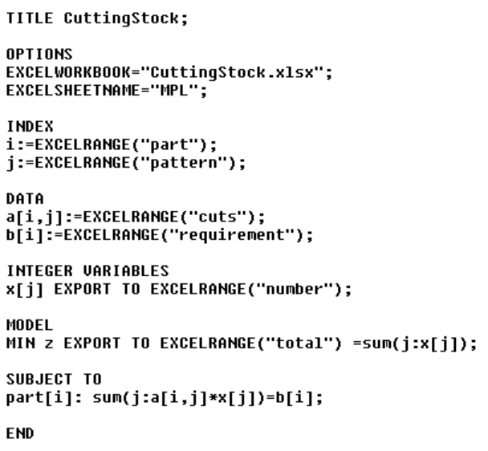
Production Planning Problems
Cutting Stock Problem – mathematical model formulation
Parameters
Decision variables
Objective
Constraints

Slide 36
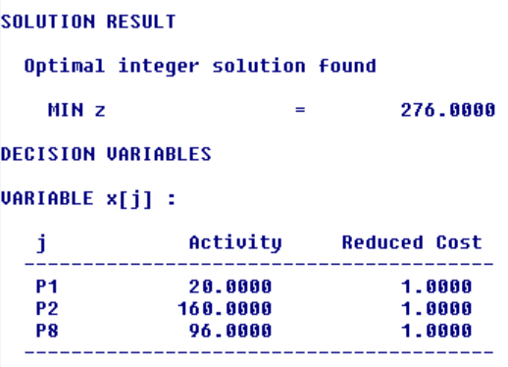
Production Planning Problems
Cutting Stock Problem – solution
Optimal solution
Decision variables
Objective value

Slide 37
Assignment Problem
3

Slide 38
Assignment Problem
Linear Assignment Problem
Definition of the problem
Two sets of items.
Each item from the first set is to be assigned to exactly one item from the second set.
Each item from the second set is to be assigned to exactly one item from the first set.
The assignment of each pair of items is evaluated.
The objective is to maximize/minimize total value of assignment.
Assumption: sizes of both sets are equal (balanced problem). Otherwise, data or a mathematical model must be changed (unbalanced problem)

Slide 39
Assignment Problem
Linear Assignment Problem
Example
Relay race for 5-member teams is organized.
A member of each team will be competing in one discipline. You are going to build a strongest team. In the table, the seasonal best performances (in minutes) of candidates are given.
Time (min) | Run | Swim | Bike | Inline | Ski
Mike | 75 | 25 | 202 | 130 | 165
Jack | 87 | 24 | 198 | 127 | 173
Peter | 68 | 19 | 195 | 121 | 164
Sean | 91 | 20 | 207 | 122 | 182
Paul | 80 | 28 | 215 | 125 | 172
Simon | 78 | 22 | 197 | 125 | 180
Tom | 75 | 25 | 205 | 127 | 178
David | 81 | 23 | 211 | 131 | 165

Slide 40
Assignment Problem
Linear Assignment Problem – matrix minimum method
Feasible solution
Decision variables
Objective value
Time (min) | Run | Swim | Bike | Inline | Ski
Mike | 75 | 25 | 202 | 130 | 165
Jack | 87 | 24 | 198 | 127 | 173
Peter | 68 | 19 | 195 | 121 | 164
Sean | 91 | 20 | 207 | 122 | 182
Paul | 80 | 28 | 215 | 125 | 172
Simon | 78 | 22 | 197 | 125 | 180
Tom | 75 | 25 | 205 | 127 | 178
David | 81 | 23 | 211 | 131 | 165

Slide 41
Assignment Problem
Linear Assignment Problem – basic mathematical model formulation
Parameters
Decision variables

Slide 42
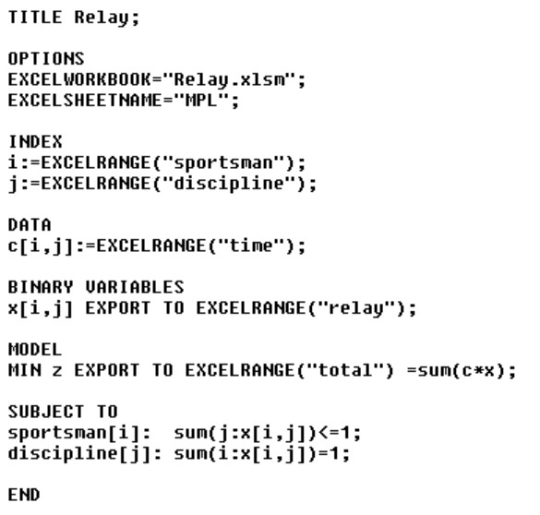
Assignment Problem
Linear Assignment Problem – basic mathematical model formulation
Balanced problem
Unbalanced problem (m > n)

Slide 43
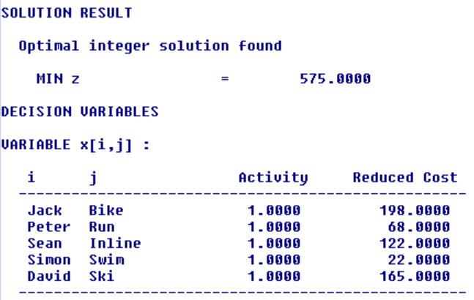
Assignment Problem
Linear Assignment Problem – solution
Optimal solution
Decision variables
Objective value
Time (min) | Run | Swim | Bike | Inline | Ski
Mike | 75 | 25 | 202 | 130 | 165
Jack | 87 | 24 | 198 | 127 | 173
Peter | 68 | 19 | 195 | 121 | 164
Sean | 91 | 20 | 207 | 122 | 182
Paul | 80 | 28 | 215 | 125 | 172
Simon | 78 | 22 | 197 | 125 | 180
Tom | 75 | 25 | 205 | 127 | 178
David | 81 | 23 | 211 | 131 | 165

Slide 44
Assignment Problem
Bottleneck Assignment Problem
Definition of the problem
Let n jobs and n parallel machines be given.
The coefficient c_{ij} is the time needed for machine j to complete job i. The objective is to minimize the latest completion time. (All machines start working on jobs at the same time).

Slide 45
Assignment Problem
Bottleneck Assignment Problem
Example
The project consists of 5 independent parts. In the company 5 departments can manage the parts individually.
Historical data shows average times (in days) departments finished similar tasks (see the table).
N.A. represents the fact the department did not work on such task in the past.
The company wants to finish the whole project as soon as possible.
Time (days) | Part 1 | Part 2 | Part 3 | Part 4 | Part 5
Dept 1 | 25 | 15 | N.A. | 17 | 25
Dept 2 | 22 | N.A. | 22 | 20 | 22
Dept 3 | 20 | 18 | 25 | 16 | 23
Dept 4 | N.A. | 20 | 30 | 21 | 28
Dept 5 | 27 | 19 | 27 | 18 | N.A.
We replace the N.A. values with high prohibitive constants, e.g. 1000.

Slide 46
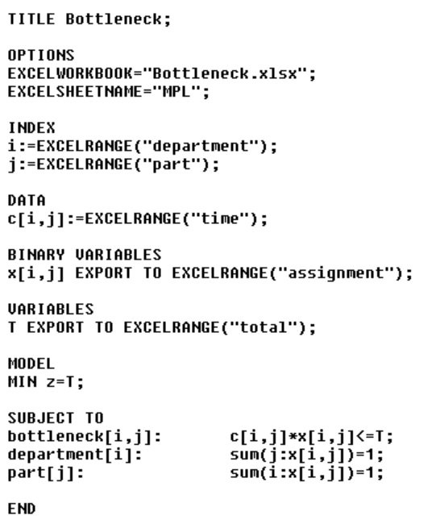
Assignment Problem
Bottleneck Assignment Problem – mathematical model formulation
Decision variables
Model

Slide 47
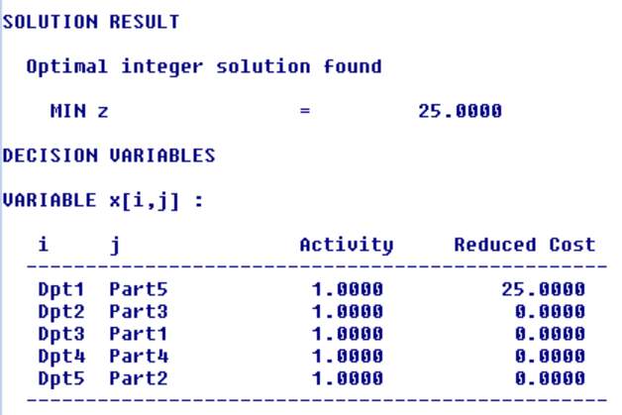
Assignment Problem
Bottleneck Assignment Problem – solution
Optimal solution
Decision variables
Objective value
Time (days) | Part 1 | Part 2 | Part 3 | Part 4 | Part 5
Dept 1 | 25 | 15 | 1000 | 17 | 25
Dept 2 | 22 | 1000 | 22 | 20 | 22
Dept 3 | 20 | 18 | 25 | 16 | 23
Dept 4 | 1000 | 20 | 30 | 21 | 28
Dept 5 | 27 | 19 | 27 | 18 | 1000

Slide 48
Assignment Problem
Perfect Matching Problem
Example
Ten students go for a school trip. To assign them to double rooms, they were asked to express their preferences (see the table, 0 = min, 10 = max).
For i < j the value p_{ij} is the preference value expressing student i wants to be in the room with student j, for i > j the value p_{ij} is the preference value expressing student j wants to be in the room with student i.
Assign students to rooms to maximize total satisfaction of the group.
Pref | 1 | 2 | 3 | 4 | 5 | 6 | 7 | 8 | 9 | 10
1 | 0 | 7 | 6 | 2 | 4 | 7 | 4 | 1 | 8 | 3
2 | 1 | 0 | 3 | 1 | 10 | 5 | 2 | 9 | 4 | 2
3 | 10 | 1 | 0 | 5 | 6 | 1 | 8 | 2 | 7 | 4
4 | 1 | 8 | 4 | 0 | 10 | 7 | 5 | 4 | 2 | 7
5 | 8 | 7 | 3 | 5 | 0 | 2 | 1 | 5 | 2 | 9
6 | 2 | 2 | 3 | 7 | 8 | 0 | 8 | 2 | 1 | 5
7 | 1 | 7 | 6 | 1 | 7 | 7 | 0 | 8 | 1 | 5
8 | 6 | 8 | 1 | 1 | 10 | 8 | 1 | 0 | 4 | 7
9 | 4 | 1 | 2 | 2 | 8 | 1 | 7 | 5 | 0 | 2
10 | 1 | 5 | 4 | 3 | 9 | 7 | 1 | 4 | 6 | 0

Slide 49
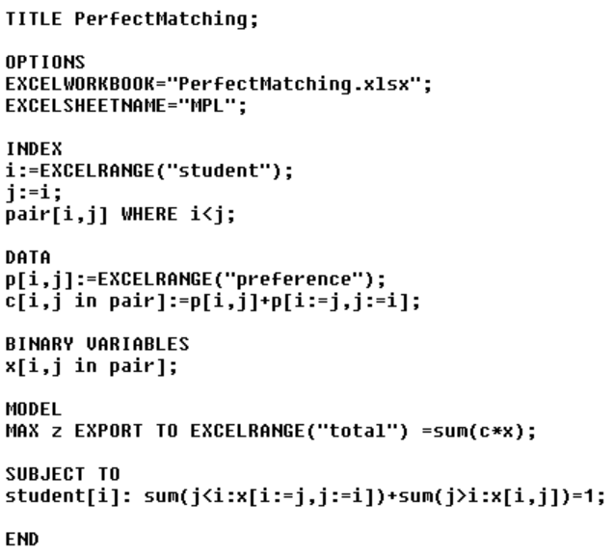
Assignment Problem
Perfect Matching Problem – mathematical model formulation
Parameters
Decision variables
Model

Slide 50
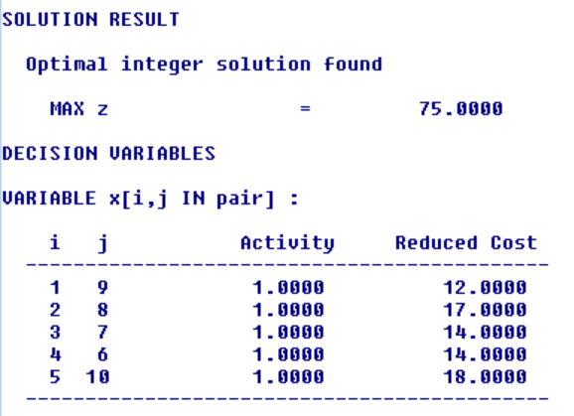
Assignment Problem
Perfect Matching Problem – solution
Optimal solution
Decision variables
Objective value
Pref | 1 | 2 | 3 | 4 | 5 | 6 | 7 | 8 | 9 | 10
1 | - | 8 | 16 | 3 | 12 | 9 | 5 | 7 | 12 | 4
2 | - | - | 4 | 4 | 9 | 17 | 7 | 17 | 5 | 7
3 | - | - | - | 9 | 9 | 4 | 14 | 3 | 9 | 8
4 | - | - | - | - | 15 | 14 | 3 | 9 | 4 | 10
5 | - | - | - | - | - | 10 | 8 | 15 | 10 | 18
6 | - | - | - | - | - | - | 15 | 10 | 2 | 12
7 | - | - | - | - | - | - | - | 9 | 8 | 6
8 | - | - | - | - | - | - | - | - | 9 | 11
9 | - | - | - | - | - | - | - | - | - | 8
10 | - | - | - | - | - | - | - | - | - | -

Slide 51
Assignment Problem
Knapsack Problem
Definition of the problem
Budget b is available for investments in n considered projects, where a_{j} is the cost for project j and c_{j} is its expected return.
The objective is to select a set of projects to maximize the total expected return while not exceeding the budget.
Decision variables
General model

Slide 52
Assignment Problem
Knapsack Problem
Example
There are 5 projects characterized by the investment cost and return.
The budget 50 000 € is available to select such projects that assure the highest total return.
Projects | P1 | P2 | P3 | P4 | P5
Cost | 12 000 | 10 000 | 15 000 | 18 000 | 16 000
Return | 20 000 | 18 000 | 22 000 | 26 000 | 21 000

Slide 53
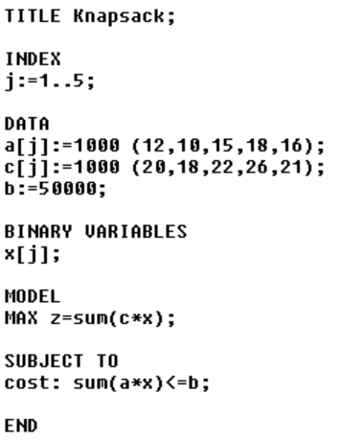
Assignment Problem
Knapsack Problem – mathematical model formulation
Decision variables
Model

Slide 54
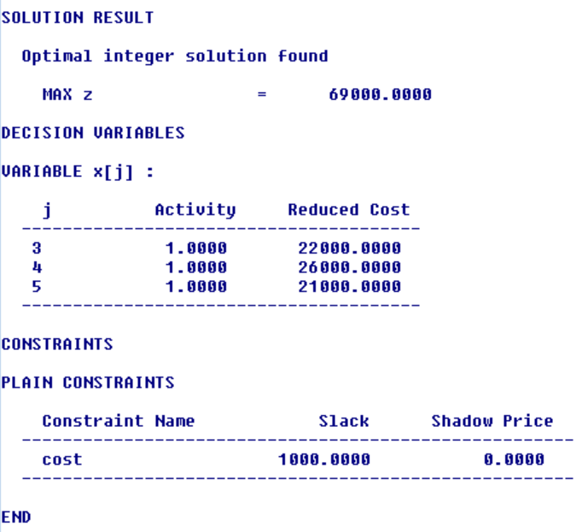
Assignment Problem
Knapsack Problem – solution
Optimal solution
Decision variables
Objective value
Slack/surplus variables

Slide 55
Graph Modeling
4

Slide 56
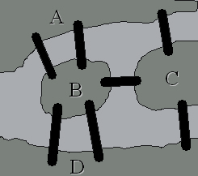
Graph Modeling
Introduction
Seven bridges of Königsberg
A
B
C
D
D

Slide 57
Graph Modeling
Basic terminology
Graph is a set G = {V, E}, where V is a set of vertices (nodes) and E is a set of edges (arcs).
Undirected arc is a set of two vertices{i, j}.
Directed arc is an ordered pair of two vertices (i, j).
In undirected graph all arcs are undirected.
In directed graph (digraph) all arcs are directed.
Mixed graph contains both undirected and directed arcs.
Two nodes that are contained in an arc are adjacent.
Two arcs that share a node are adjacent.
An arc and a node contained in that arc are incident.
Degree of a node (in undirected graph) is a number of incident arcs.

Slide 58
Graph Modeling
Basic terminology
In-degree of a node (in directed graph) is a number of incident arcs in which the node is the terminal one.
Out-degree of a node (in directed graph) is a number of incident arcs in which the node is the initial one.
Walk from node i to node j is a sequence of nodes and arcs, where i is the initial node and j is the terminal node (nodes and arcs may be repeated).
Trail is a walk with no repeated arc.
Path is a trail with no repeated node.
Cycle is closed walk (the initial node is the terminal one).
In directed path (in directed graph) a direction of all arcs is respected.
In undirected path (in directed graph) a direction of all arcs may not be respected.

Slide 59
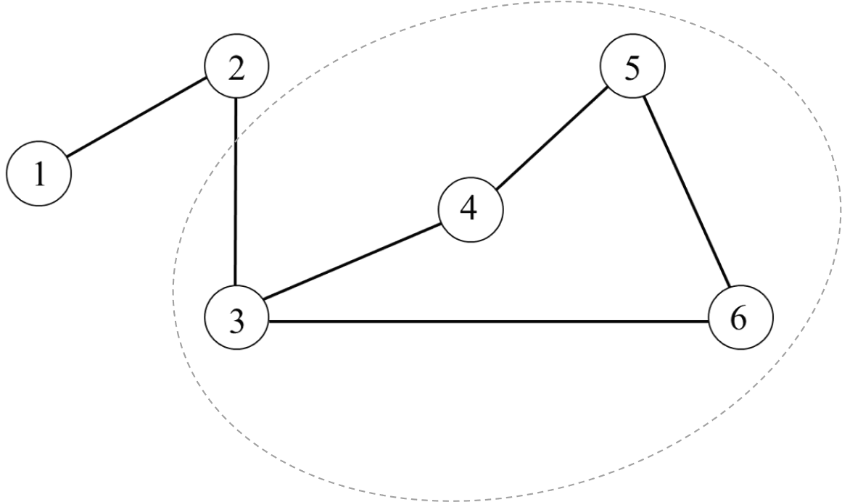
Graph Modeling
Basic terminology
Cycle (circuit)

Slide 60
Graph Modeling
Basic terminology
Undirected graph is connected if between each pair of nodes there is a path.
Directed graph is connected if there is a directed or undirected path between each pair of nodes.
Directed graph is strongly connected if there is a directed path between each pair of nodes.
Graph is complete if there is an arc between each pair of nodes.
Tree is a connected undirected graph with no cycles.
Subgraph of graph G = {V, E} is a graph G′ = {V′, E′}, where V′ ⊆ V and E′ ⊆ E.
Spanning tree of the graph G is a subgraph G′, where V′ = V, and which is a tree.
Valued graph has numbers associated with nodes or/and arcs.
The minimum spanning tree of a graph is the tree with the minimum sum of edge ratings.

Slide 61
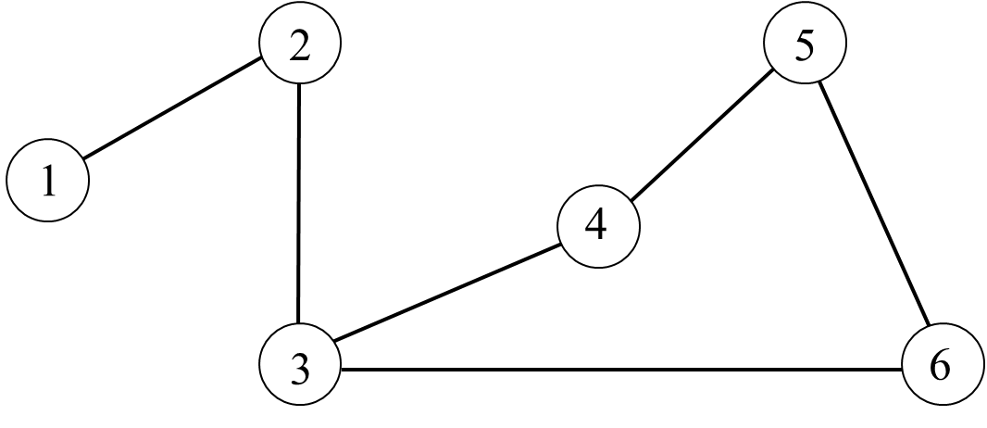
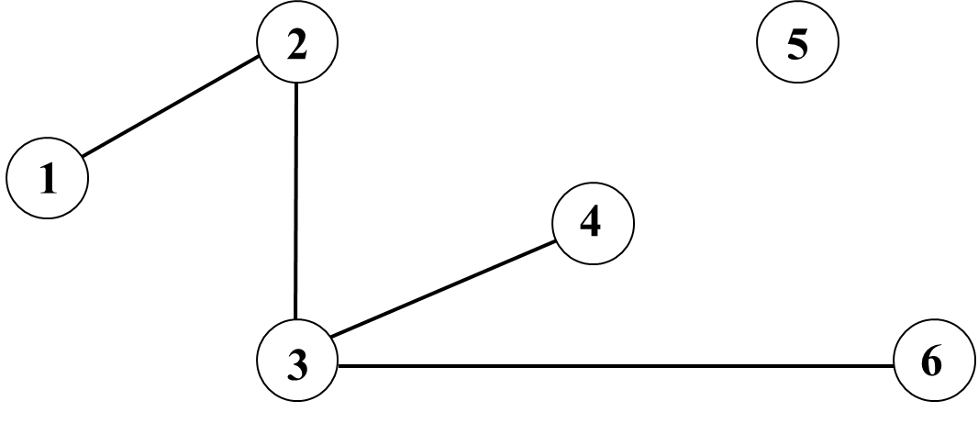
Graph Modeling
Basic terminology
Unconnected graph
Connected graph

Slide 62
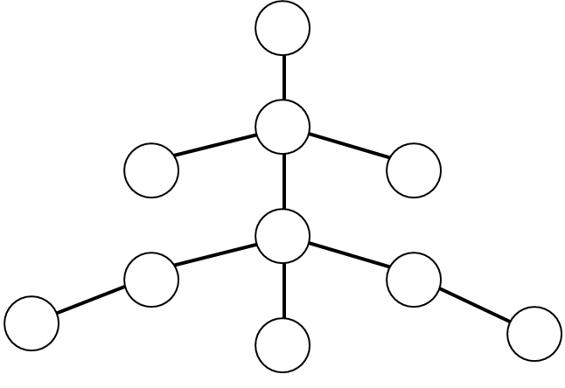
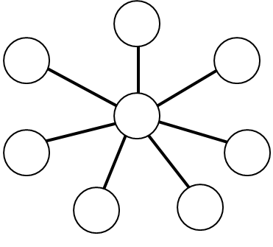
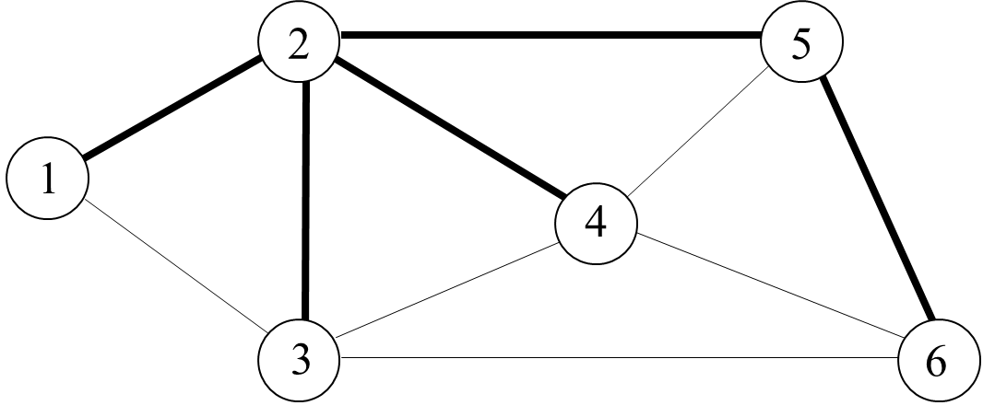
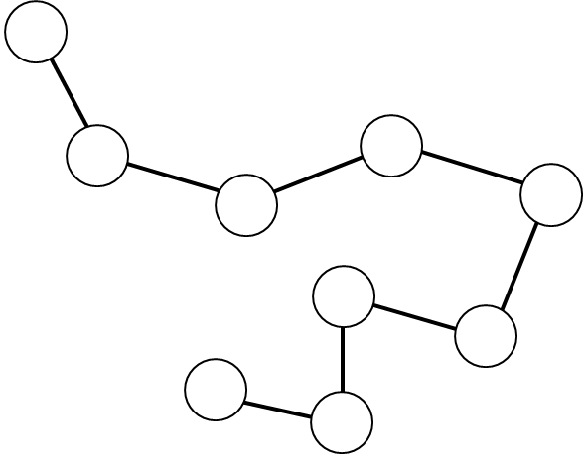
Graph Modeling
Basic terminology
Spanning tree
Tree

Slide 63
Graph Modeling
Basic terminology
A net graph is a continuous, oriented, valued graph with one input and one output.
Hamiltonian cycle is a cycle that includes each node of the graph exactly once.
Eulerian cycle includes each arc of the graph exactly once.
Eulerian trail is a trail that includes each arc of the graph.
Eulerian graph is a graph in which the Eulerian cycle can be found.

Slide 64
Graph Modeling
Maximum Flow Problem
Definition of the problem
G = {V, E} be a digraph with the flow capacity k_{ij} given for each arc (i, j).
The objective is to identify the maximum amount of flow that can occur from source node s to sink node d.

Slide 65
Graph Modeling
Maximum Flow Problem
Example
Will you find the maximum flow from node 1 to node 6 for a graph given by the following table.
Arc | Capacity | Arc | Capacity
(1,2) | 10 | (3,5) | 7
(1,3) | 10 | (3,6) | 5
(1,4) | 12 | (4,3) | 3
(2,5) | 11 | (4,6) | 9
(3,4) | 3 | (5,6) | 18
2
11
10
5
7
1
10
3
5
18
Transformation of the grpah
Graph is transformed into complete digraph.
Capacities for non-existing arcs are zero.
3
6
12
9
4

Slide 66
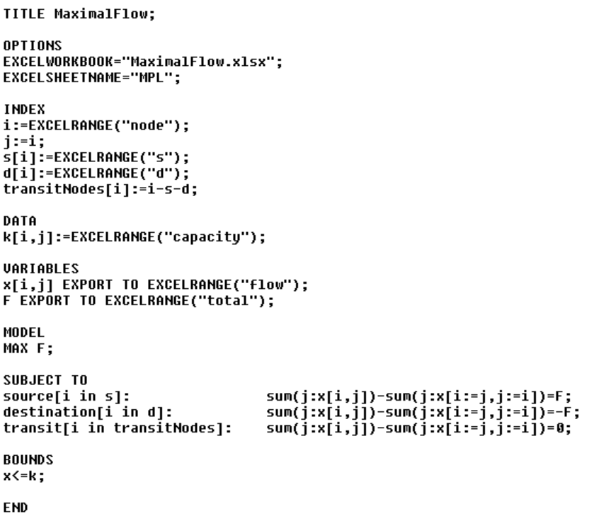
Graph Modeling
Maximum Flow Problem – mathematical model formulation
Decision variables
Model

Slide 67
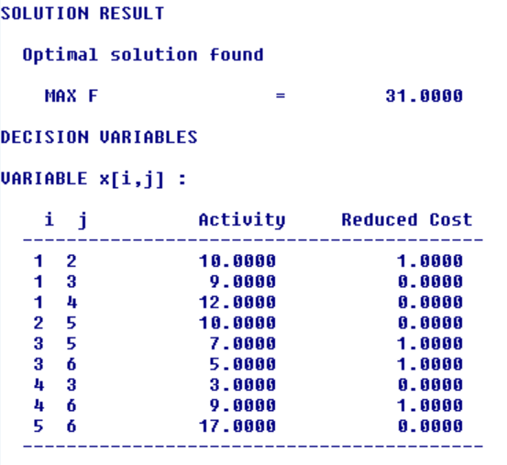
Graph Modeling
Maximum Flow Problem – solution
Optimal solution
Decision variables
see the picture
Objective value
2
10
10
5
7
1
9
3
5
17
3
6
12
9
4

Slide 68
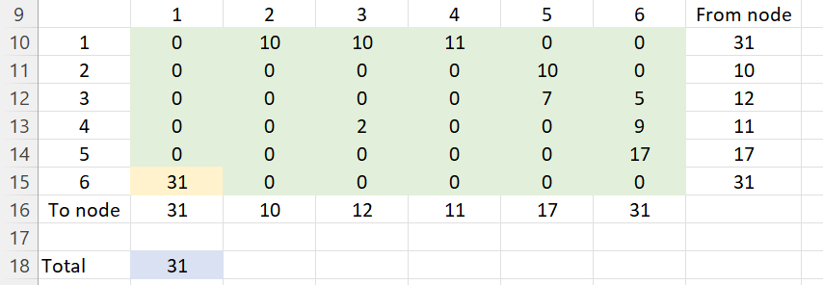
Graph Modeling
Maximum Flow Problem
Alternative approach to modelling
In complete digraph we set capacity k_{ds} = M (big number).
Decision variables
General model

Slide 69
Graph Modeling
Minimum-Cost Flow Problem
Definition of the problem
G = {V, E} is a digraph with the flow capacity k_{ij} and unit cost c_{ij} given for each arc (i, j).
The objective is to satisfy required total flow F₀ (from source node s to sink node d) with the minimum total cost.
Transformation of the grpah
Graph is transformed into complete digraph.
Capacities for non-existing arcs are zero.

Slide 70
Graph Modeling
Minimum-Cost Flow Problem
Example
Will you find the flow (from 1 to 6) of value 25 with the minimal total cost. In the table, capacity and unit cost for each arc are given.
Arc | Capacity | Cost | Arc | Capacity | Cost
(1,2) | 10 | 5 | (3,5) | 7 | 6
(1,3) | 10 | 10 | (3,6) | 5 | 9
(1,4) | 12 | 20 | (4,3) | 3 | 12
(2,5) | 11 | 11 | (4,6) | 9 | 17
(3,4) | 3 | 12 | (5,6) | 18 | 8
2
11
10
5
7
1
10
3
5
18
3
6
12
9
4

Slide 71
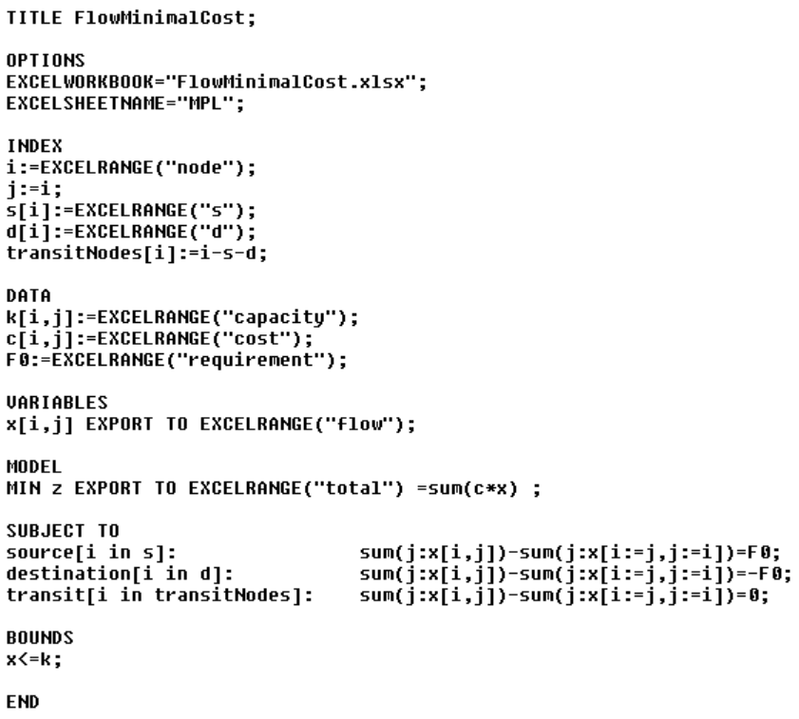
Graph Modeling
Minimum-Cost Flow Problem – mathematical model formulation
Decision variables
Model

Slide 72
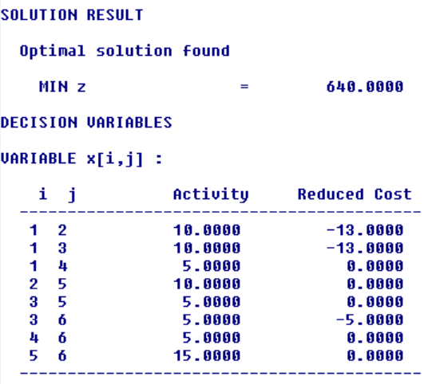
Graph Modeling
Minimum-Cost Flow Problem – solution
Optimal solution
Decision variables
see the picture
Objective value
2
10
10
5
5
1
10
3
5
15
6
5
5
4

Slide 73
Graph Modeling
Transshipment Problem
Definition of the problem
G = {V, E} is a digraph with three sets of nodes: set of sources V_{s}, set of destinations V_{d} and set of transshipment nodes V_{t}.
Flow capacity k_{ij} and unit cost c_{ij} are given for each arc (i, j).
Demand in all destinations has to be satisfied without exceeding any supply.
The objective is to minimize total flow cost. Suppose total demand is equal to total supply.
Assumptions

Slide 74
Graph Modeling
Transshipment Problem
Example
It is necessary to transport empty containers from sources to destinations.
In the graph, nodes 1 and 3 are sources with supply 15 and 10 containers, nodes 4 and 6 are destinations with demand 5 and 20 containers.
The table gives the capacity for each arc and the cost of transporting one container.
The objective is to minimize total cost.
0
2
11
Arc | Capacity | Cost | Arc | Capacity | Cost
(1,2) | 10 | 5 | (3,5) | 7 | 6
(1,3) | 10 | 10 | (3,6) | 5 | 9
(1,4) | 12 | 20 | (4,3) | 3 | 12
(2,5) | 11 | 11 | (4,6) | 9 | 17
(3,4) | 3 | 12 | (5,6) | 18 | 8
0
10
5
7
15
10
10
1
3
18
5
3
6
12
9
4
-20
-5

Slide 75
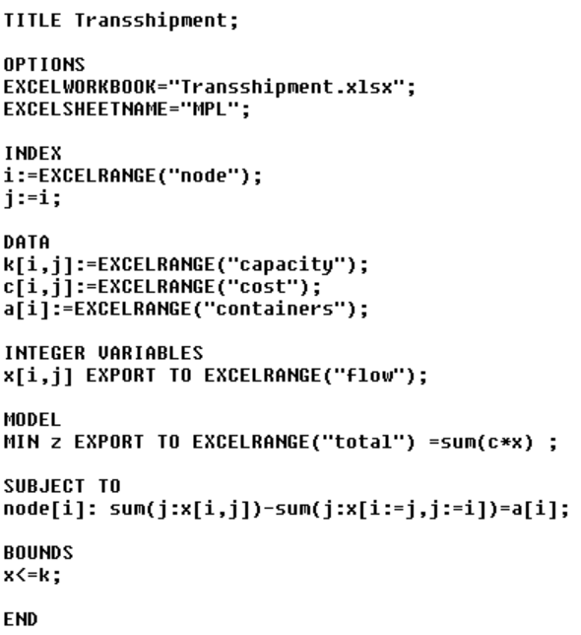
Graph Modeling
Transshipment Problem – mathematical model formulation
Transformation of the grpah
Graph is transformed into complete digraph.
Capacities for non-existing arcs are zero.
Decision variables
Model

Slide 76
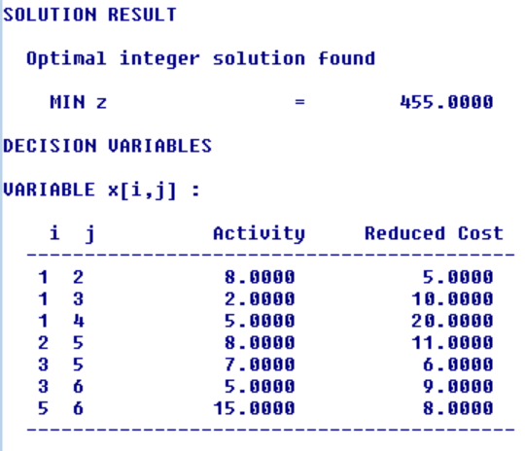
Graph Modeling
Transshipment Problem – solution
Optimal solution
Decision variables
see the picture
Objective value

Slide 77
Graph Modeling
Minimal Spanning Tree
Definition of the problem
G = {V, E} is an undirected graph with cost c_{ij} given for each arc {i, j}.
The objective is to search a spanning tree of G minimizing total cost.
Graph transformation
Set of undirected arcs E is transformed to set of directed arcs A in the following way:
Each arc {i, j} ∈ E is replaced with directed arcs (i, j) ∈ A a (j, i) ∈ A, c_{ij} = c_{ji}.

Slide 78
Graph Modeling
Minimal Spanning Tree
Example
The company has to install 6 information boards in the city park. They must be connected by a cable placed under pavements.
Distances (in ten meters) between boards can be found in the table. If there is no pavement between a pair of boards, prohibitive value 100 is set.
The objective is to minimize total cost both on excavation job and on cable itself.
Boards | 1 | 2 | 3 | 4 | 5 | 6
1 | 0 | 6 | 5 | 100 | 100 | 100
2 | 6 | 0 | 7 | 2 | 4 | 100
3 | 5 | 7 | 0 | 6 | 100 | 8
4 | 100 | 2 | 6 | 0 | 3 | 4
5 | 100 | 4 | 100 | 3 | 0 | 5
6 | 100 | 100 | 8 | 4 | 5 | 0
2
4
5
6
2
3
1
4
7
5
6
4
5
3
6
8

Slide 79
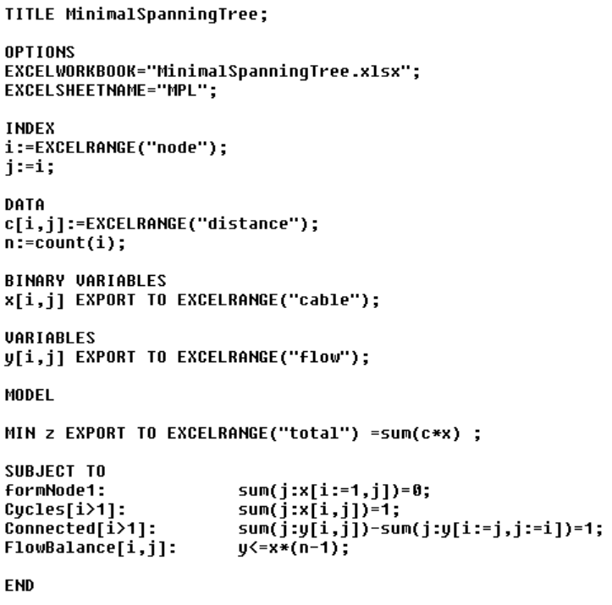
Graph Modeling
Minimal Spanning Tree – mathematical model formulation
Decision variables
Model

Slide 80
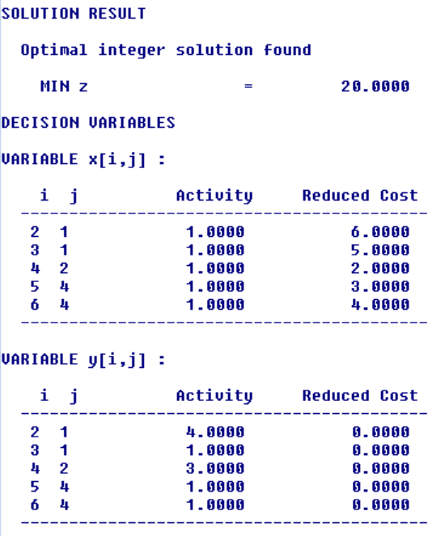
Graph Modeling
Minimal Spanning Tree – solution
2
4
5
6
2
3
Optimal solution
Objective value
1
4
7
5
6
4
5
3
6
8
Boards | 1 | 2 | 3 | 4 | 5 | 6
1 | 0 | 6 | 5 | 100 | 100 | 100
2 | 6 | 0 | 7 | 2 | 4 | 100
3 | 5 | 7 | 0 | 6 | 100 | 8
4 | 100 | 2 | 6 | 0 | 3 | 4
5 | 100 | 4 | 100 | 3 | 0 | 5
6 | 100 | 100 | 8 | 4 | 5 | 0

Slide 81
Graph Modeling
Minimal Spanning Tree – solution
2
4
5
6
2
3
Optimal solution
Objective value
1
4
7
5
6
4
5
3
6
8
Boards | 1 | 2 | 3 | 4 | 5 | 6
1 | 0 | 6 | 5 | 100 | 100 | 100
2 | 6 | 0 | 7 | 2 | 4 | 100
3 | 5 | 7 | 0 | 6 | 100 | 8
4 | 100 | 2 | 6 | 0 | 3 | 4
5 | 100 | 4 | 100 | 3 | 0 | 5
6 | 100 | 100 | 8 | 4 | 5 | 0

Slide 82
Transportation and Routing Problems
5

Slide 83
Transportation and Routing Problems
Transportation Problem
Definition of the problem
Transport of homogeneous product.
Set of sources with limited supply.
Set of destinations with demand (requirement).
Unit shipping cost for all pairs of sources and destinations.
The goal is to satisfy all requirements without exceeding any supply.
The objective is to find shipments to minimize total shipping cost.
Type of the problem
Balanced – total supply is equal to total demand.
Unbalanced – total supply is different from total demand, it is possible to make the problem balanced:
adding dummy destination,
finding additional source or adding dummy source (with the possibility of unsatisfied requirement).

Slide 84
Transportation and Routing Problems
Transportation Problem
Example
A company producing petroleum products is establishing four new gas stations in Tábor, Příbram, Jindřichův Hradec and Písek
The product is gasoline, which will be imported from warehouses in Pilsen, České Budějovice and Jihlava.
Plzeň
Příbram
Tábor
Písek
Jihlava
Jindřichův Hradec
České Budějovice

Slide 85
Transportation and Routing Problems
Transportation Problem
Example
The table shows the weekly supply of warehouses and the planned weekly requirements of filling stations (in hectoliters). Gasoline will be transported by road (once a week). The table contains unit sipping costs for transporting one hectoliter of gasoline from sources to destinations (in CZK).
The objective is to plan the transportation of gasoline so that the total shipping costs are minimal. This shipping schedule, of course, must satisfy requirement of each destination, and must not exceed supply of any warehouse.
Source \ Destination | Tábor | Příbram | Jindřichův Hradec | Písek | Supply (hectoliter)
Plzeň | 10 | 8 | 20 | 9 | 110
České Budějovice | 9 | 13 | 6 | 13 | 160
Jihlava | 7 | 11 | 10 | 18 | 180
Demand (hectoliters) | 90 | 130 | 80 | 120

Slide 86
Transportation and Routing Problems
Transportation Problem
Example
Balancing Transportation Problem by adding dummy customer.
Source \ Destination | Tábor | Příbram | Jindřichův Hradec | Písek | Dummy destination | Supply (hectoliter)
Plzeň | 10 | 8 | 20 | 9 | 0 | 110
České Budějovice | 9 | 13 | 6 | 13 | 0 | 160
Jihlava | 7 | 11 | 10 | 18 | 0 | 180
Demand (hectoliters) | 90 | 130 | 80 | 120 | 30

Slide 87
Transportation and Routing Problems
Transportation Problem – feasible solution
North-West Corner Method
Select the upper left-hand corner cell of the transportation table and allocate as many units as possible equal to the minimum between available supply and demand, i.e., min(s1, d1).
Adjust the supply and demand numbers in the respective rows and columns.
If the demand for the first cell is satisfied, then move horizontally to the next cell in the second column.
If the supply for the first row is exhausted, then move down to the first cell in the second row.
If for any cell, supply equals demand, then the next allocation can be made in cell either in the next row or column.
Continue the process until all supply and demand values are exhausted.
Source \ Destination | Tábor | Příbram | Jindřichův Hradec | Písek | Dummy destination | Supply (hectoliter)
Plzeň | 90 | 20 | 0 | 0 | 0 | 110
České Budějovice | 0 | 110 | 50 | 0 | 0 | 160
Jihlava | 0 | 0 | 30 | 120 | 30 | 180
Demand (hectoliters) | 90 | 130 | 80 | 120 | 30
Objective value

Slide 88
Transportation and Routing Problems
Transportation Problem – feasible solution
Matrix Minimum Method
Find a minimal cost for all possible shipments.
Assign the shipment to the pair od source and destination with the minimal cost found in step 1. The value of the shipment is equal to the minimum of remaining supply and remaining demand for this pair.
Decrease remaining supply and remaining demand, for the pair of the source and destination, by the shipment calculated in step 2.
If there is some remaining demand go to step 1, otherwise, the feasible solution is found.
Source \ Destination | Tábor | Příbram | Jindřichův Hradec | Písek | Dummy destination | Supply (hectoliter)
Plzeň | 0 | 110 | 0 | 0 | 0 | 110
České Budějovice | 0 | 0 | 80 | 80 | 0 | 160
Jihlava | 90 | 20 | 0 | 40 | 30 | 180
Demand (hectoliters) | 90 | 130 | 80 | 120 | 30
Objective value

Slide 89
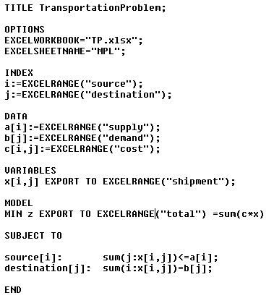
Transportation and Routing Problems
Transportation Problem
General mathematical model

Slide 90
Transportation and Routing Problems
Transportation Problem – optimal solution
Optimal solution
Decision variables
Objective value
Slack/surplus variables
Source \ Destination | Tábor | Příbram | Jindřichův Hradec | Písek | Supply (hectoliter)
Plzeň | 0 | 40 | 0 | 70 | 110
České Budějovice | 0 | 0 | 80 | 50 | 160
Jihlava | 90 | 90 | 0 | 0 | 180
Demand (hectoliters) | 90 | 130 | 80 | 120

Slide 91
Transportation and Routing Problems
Container Transportation Problem
Based on the transportation problem.
Goods is transported in containers of the same capacity.
The shipping costs are not associated with the transported unit, but with the use of one container between the source and the destination.
The objective is to determine the shipments between sources and destinations and the number of containers used for the transport at the minimal total transportation costs.

Slide 92
Transportation and Routing Problems
Container Transportation Problem
Example
Let's assume that in the previous example, the transport company will charge prices for the transport (rental) of one tank between individual sources and destinations.
Tanks with a capacity of 20 hl can be used for transport.
The objective is to determine how many hectoliters of gasoline will be shipped between the individual locations, but in addition, to determine how many tanks will be used for this transport so that the total shipping costs are minimal.
Source \ Destination | Tábor | Příbram | Jindřichův Hradec | Písek | Supply (hectoliter)
Plzeň | 210 | 130 | 420 | 190 | 110
České Budějovice | 170 | 260 | 130 | 260 | 160
Jihlava | 150 | 210 | 180 | 340 | 180
Demand (hectoliters) | 90 | 130 | 80 | 120

Slide 93
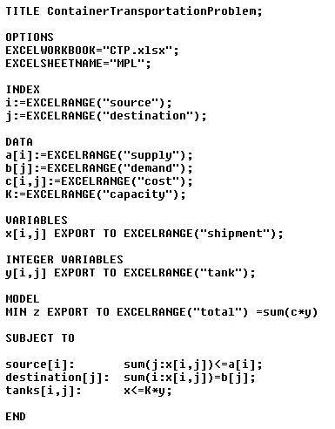
Transportation and Routing Problems
Container Transportation Problem – mathematical model formulation
Mathematical model is based on the mathematical model of transportation problem.
Decision variables
Objective
Constraints
It is necessary to add following constraints to the constraints of transportation problem:

Slide 94
Transportation and Routing Problems
Container Transportation Problem – optimal solution
Optimal solution
Decision variables (transferred volume)
Objective value
Slack/surplus variables
Source \ Destination | Tábor | Příbram | Jindřichův Hradec | Písek | Supply (hectoliter)
Plzeň | 0 | 70 | 0 | 40 | 110
České Budějovice | 0 | 0 | 80 | 80 | 160
Jihlava | 90 | 60 | 0 | 0 | 180
Demand (hectoliters) | 90 | 130 | 80 | 120

Slide 95
Transportation and Routing Problems
Container Transportation Problem – optimal solution
Optimal solution
Decision variables (number of tankers)
Source \ Destination | Tábor | Příbram | Jindřichův Hradec | Písek | Supply (hectoliter)
Plzeň | 0 | 4 | 0 | 2 | 110
České Budějovice | 0 | 0 | 4 | 4 | 160
Jihlava | 5 | 3 | 0 | 0 | 180
Demand (hectoliters) | 90 | 130 | 80 | 120

Slide 96
Transportation and Routing Problems
Bin Packing Problem
Definition of the BPP I
A set of n items that can be packed into m containers.
The weight w_{j} and value c_{j} of item j are given.
Let K_{i} be a weight capacity of container i.
The objective is to maximize the total value of all assigned items.

Slide 97
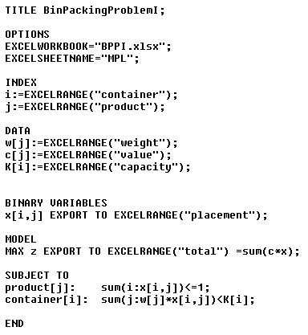
Transportation and Routing Problems
Bin Packing Problem – BPP I
Decision variables
Model

Slide 98
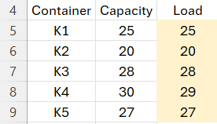
Transportation and Routing Problems
Bin Packing Problem (BPP I) – optimal solution
Optimal solution
Placement of products in containers
Weight of container load

Slide 99
Transportation and Routing Problems
Bin Packing Problem
Definition of the problem 2.
A set of n types of items that have to be transported using m containers of identical weight capacity K.
Let w_{j} be a weight of item type j and r_{j} be a number of them to be transported.
The objective is to minimize a number of containers used to transport all items.

Slide 100
Transportation and Routing Problems
Bin Packing Problem – BPP II
Example
Products must be transported to the client using identical containers. In the table, a unit weight of each product type (in kg) and a number of them to transport are given. The weight capacity of the container is 500 kg.
The objective is to minimize a number of used containers.
BinPacking | Weight | Number
Product 1 | 20 | 13
Product 2 | 22 | 15
Product 3 | 18 | 25
Product 4 | 15 | 30
Product 5 | 21 | 18
Product 6 | 16 | 35

Slide 101
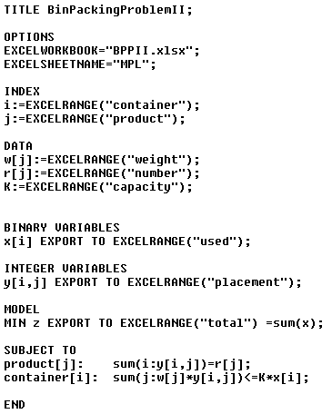
Transportation and Routing Problems
Bin Packing Problem – BPP II
Decision variables
Model

Slide 102
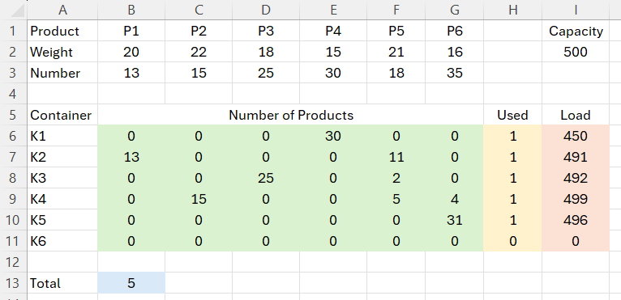
Transportation and Routing Problems
Bin Packing Problem (BPP II) – optimal solution
Optimal solution
Objective value

Slide 103
Transportation and Routing Problems
Shortest Path Problem
The objective is to find the shortest path between a pair of nodes.
A task solved on a daily basis when using navigation in a car or searching for a connection on a map portal.
There are many algorithms that can be used to easily find all distances between all pairs of nodes in a given graph. Dijkstra's algorithm is designed to find the shortest paths from one particular node to all other nodes in the graph. It can be used repeatedly for different default nodes.
A simple mathematical model can also be used for the solution.

Slide 104
Transportation and Routing Problems
Shortest Path Problem
Example
A distribution firm has been awarded a contract to transport an overweight cargo from location 1 to location 9.
Distances in kilometers are given for all arcs in the graph. Due to the fact that some roads have sections with dangerous drops, they can only be transported in one direction, which is indicated by oriented arcs.
The objective is to travel the minimum distance when transporting cargo.
2
19
5
7
15
7
10
1
10
5
13
11
8
12
3
17
6
9
9
8
4
14
10
4
18
6
16

Slide 105
Transportation and Routing Problems
Shortest Path Problem
Table with lengths of arcs
Arcs | 1 | 2 | 3 | 4 | 5 | 6 | 7 | 8 | 9
1 | 1000 | 5 | 8 | 9 | 1000 | 1000 | 1000 | 1000 | 1000
2 | 5 | 1000 | 10 | 1000 | 1000 | 1000 | 19 | 1000 | 1000
3 | 1000 | 10 | 1000 | 4 | 13 | 14 | 1000 | 17 | 1000
4 | 9 | 1000 | 1000 | 1000 | 1000 | 16 | 1000 | 1000 | 1000
5 | 1000 | 15 | 13 | 1000 | 1000 | 1000 | 7 | 1000 | 1000
6 | 1000 | 1000 | 1000 | 16 | 1000 | 1000 | 1000 | 10 | 18
7 | 1000 | 19 | 1000 | 1000 | 7 | 1000 | 1000 | 1000 | 10
8 | 1000 | 1000 | 17 | 1000 | 12 | 10 | 11 | 1000 | 1000
9 | 1000 | 1000 | 1000 | 1000 | 1000 | 18 | 10 | 6 | 1000

Slide 106
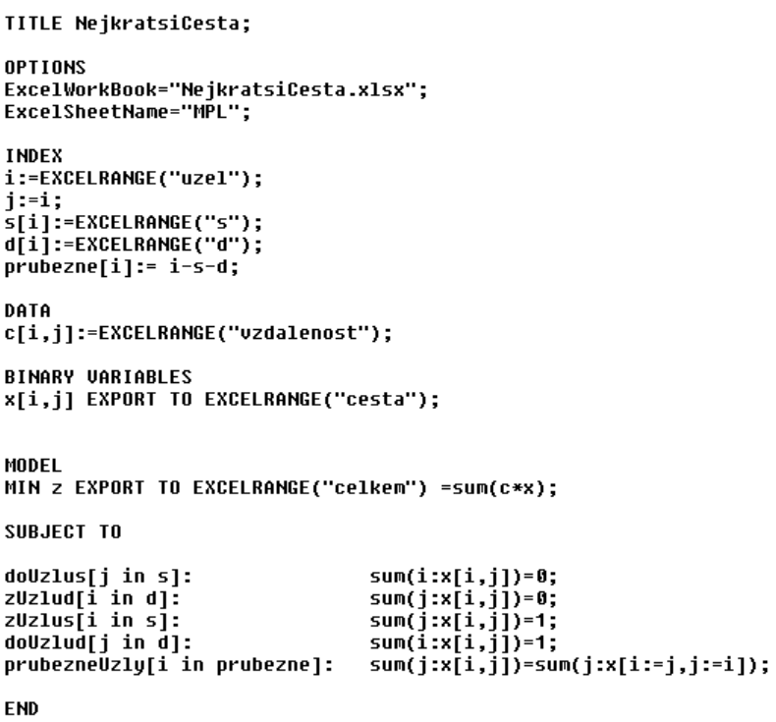
Transportation and Routing Problems
Minimal Path Problem – mathematical model
Decision variables
Model

Slide 107
Transportation and Routing Problems
Shortest Path Problem – optimal solution
Optimal solution
Objective value
Arcs in the path
Arcs | 1 | 2 | 3 | 4 | 5 | 6 | 7 | 8 | 9
1 | 0 | 1 | 0 | 0 | 0 | 0 | 0 | 0 | 0
2 | 0 | 0 | 0 | 0 | 0 | 0 | 1 | 0 | 0
3 | 0 | 0 | 0 | 0 | 0 | 0 | 0 | 0 | 0
4 | 0 | 0 | 0 | 0 | 0 | 0 | 0 | 0 | 0
5 | 0 | 0 | 0 | 0 | 0 | 0 | 0 | 0 | 0
6 | 0 | 0 | 0 | 0 | 0 | 0 | 0 | 0 | 0
7 | 0 | 0 | 0 | 0 | 0 | 0 | 0 | 0 | 1
8 | 0 | 0 | 0 | 0 | 0 | 0 | 0 | 0 | 0
9 | 0 | 0 | 0 | 0 | 0 | 0 | 0 | 0 | 0

Slide 108
Transportation and Routing Problems
Shortest Path Problem – optimal solution
Optimal solution
Objective value
Arcs in the path
2
19
5
7
15
7
10
1
10
5
13
11
8
12
3
17
6
9
9
8
4
14
10
4
18
6
16

Slide 109
Transportation and Routing Problems
Treveling Salesman Problem
Definition of the problem
Set of customers.
Each customer must be visited exactly once.
Cyclical route starts and ends in the home city (index 1).
Evaluation of direct travel form location i to location j is denoted by c_{ij} (distance, time or cost).
Objective is to minimize total length of the route, total travel time or total travel cost.

Slide 110
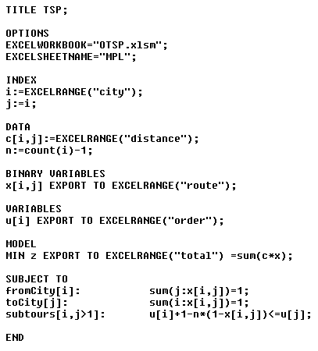
Transportation and Routing Problems
Treveling Salesman Problem – mathematical model
Decision variables
Model

Slide 111
Transportation and Routing Problems
Treveling Salesman Problem
Example
A sales representative of the brewery located in Velvary must visit 7 pubs in 7 cities.
In the following table, distances (in km) correspond to direct links (roads) between cities. A dash indicates there is no direct road between cities.
The objective is to visit all pubs minimizing total length of the tour.
Town | Velvary | Kralupy | Libcice | Slaný | Zlonice | Vraný | Bříza | Veltrusy
Velvary | 0 | 8 | - | 13 | 10 | - | 12 | 9
Kralupy | 8 | 0 | 6 | 16 | - | - | - | 4
Libcice | - | 6 | 0 | - | - | - | - | -
Slaný | 13 | 16 | - | 0 | 7 | - | - | -
Zlonice | 10 | - | - | 7 | 0 | 7 | 13 | -
Vraný | - | - | - | - | 7 | 0 | 15 | -
Bříza | 12 | - | - | - | 13 | 15 | 0 | 13
Veltrusy | 9 | 4 | - | - | - | - | 13 | 0

Slide 112
Transportation and Routing Problems
Treveling Salesman Problem
Example
The following table contains distances between all pairs of cities.
Town | Velvary | Kralupy | Libcice | Slaný | Zlonice | Vraný | Bříza | Veltrusy
Velvary | 0 | 8 | 14 | 13 | 10 | 17 | 12 | 9
Kralupy | 8 | 0 | 6 | 16 | 18 | 25 | 17 | 4
Libcice | 14 | 6 | 0 | 22 | 24 | 31 | 23 | 10
Slaný | 13 | 16 | 22 | 0 | 7 | 14 | 20 | 20
Zlonice | 10 | 18 | 24 | 7 | 0 | 7 | 13 | 19
Vraný | 17 | 25 | 31 | 14 | 7 | 0 | 15 | 26
Bříza | 12 | 17 | 23 | 20 | 13 | 15 | 0 | 13
Veltrusy | 9 | 4 | 10 | 20 | 19 | 26 | 13 | 0

Slide 113
Transportation and Routing Problems
Treveling Salesman Problem – feasible solution
The Nearest Neighbor Algorithm
Select any node as the initial one of the tour.
Find the nearest node (not selected before) to the last node and add it to the tour. If it is impossible (all nodes have been selected) then add the initial node to the tour (Hamiltonian cycle is created) and go to Step 4.
Go to Step 2.
End.
Objective value
Town | Velvary | Kralupy | Libcice | Slaný | Zlonice | Vraný | Bříza | Veltrusy
Velvary | 0 | 8 | 14 | 13 | 10 | 17 | 12 | 9
Kralupy | 8 | 0 | 6 | 16 | 18 | 25 | 17 | 4
Libcice | 14 | 6 | 0 | 22 | 24 | 31 | 23 | 10
Slaný | 13 | 16 | 22 | 0 | 7 | 14 | 20 | 20
Zlonice | 10 | 18 | 24 | 7 | 0 | 7 | 13 | 19
Vraný | 17 | 25 | 31 | 14 | 7 | 0 | 15 | 26
Bříza | 12 | 17 | 23 | 20 | 13 | 15 | 0 | 13
Veltrusy | 9 | 4 | 10 | 20 | 19 | 26 | 13 | 0

Slide 114
Transportation and Routing Problems
Treveling Salesman Problem – optimal solution
Optimal solution
Objective value
Town | Velvary | Kralupy | Libcice | Slaný | Zlonice | Vraný | Bříza | Veltrusy
Velvary | 0 | 8 | 14 | 13 | 10 | 17 | 12 | 9
Kralupy | 8 | 0 | 6 | 16 | 18 | 25 | 17 | 4
Libcice | 14 | 6 | 0 | 22 | 24 | 31 | 23 | 10
Slaný | 13 | 16 | 22 | 0 | 7 | 14 | 20 | 20
Zlonice | 10 | 18 | 24 | 7 | 0 | 7 | 13 | 19
Vraný | 17 | 25 | 31 | 14 | 7 | 0 | 15 | 26
Bříza | 12 | 17 | 23 | 20 | 13 | 15 | 0 | 13
Veltrusy | 9 | 4 | 10 | 20 | 19 | 26 | 13 | 0

Slide 115
Transportation and Routing Problems
Treveling Salesman Problem with Time Windows
Definition of the problem
Each location i has to be visited within time interval <e_{i}, l_{i}>.
A vehicle spends given time S_{i} at location i.
Let d_{ij} be the travel time between locations i and j.
The objective is to determine the minimal Hamiltonian cycle (in terms of distance) respecting all time windows.

Slide 116
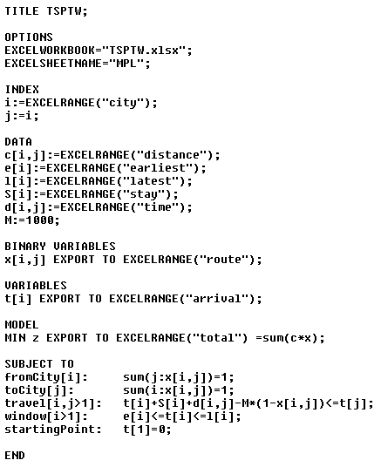
Transportation and Routing Problems
Treveling Salesman Problem with Time Windows – mathematical model
Decision variables
Model
Variables u_{i} are eliminated and constraints are replaced with

Slide 117
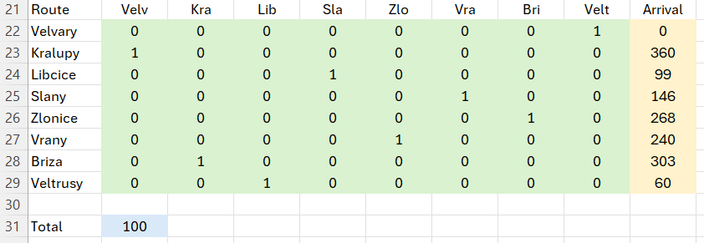
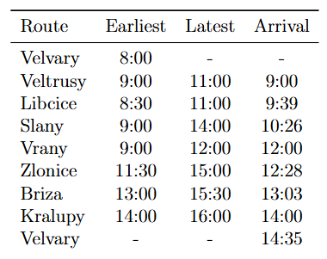
Transportation and Routing Problems
Treveling Salesman Problem with Time Windows – optimal solution
Optimal solution
Objective value

Slide 118
Transportation and Routing Problems
Open Treveling Salesman Problem
Definition of the problem
Set of customers.
Each customer must be visited exactly once.
Vehicle does not return to the home city (index 1).
Objective is to minimize total length of the route, total travel time or total travel cost.

Slide 119
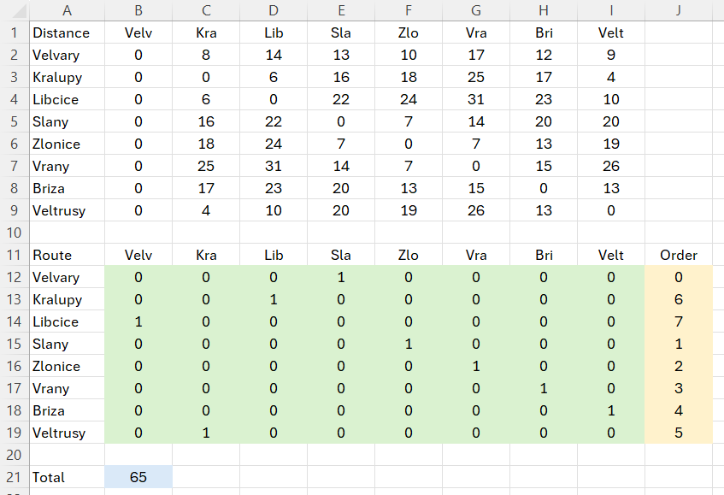
Transportation and Routing Problems
Open Treveling Salesman Problem – optimal solution
Optimal solution
Objective value

Slide 120
Transportation and Routing Problems
Treveling Salesman Problem in Production
Definition of the problem
The company produces utility glass (beakers, ashtrays, bottles, bowls, vases and test tubes). The production line measures the size of the drop of glass from the storage room into the press, on which the mold for the given product is placed. The conversion times (in hours) for changing the mold and setting the drop size are given in the table.
The company wants to minimize costs that correspond with downtime due to changing the mold and setting the drop.
The production batch always begins and ends with the production of a beaker.
The production batch begins with the production of the beaker and ends with any product.
The production batch begins with the production of the beaker and ends with the production of the bottle.
Product | Beaker | Ashtray | Bottle | Bowl | Vase | Test tube
Beaker | 0 | 6 | 8 | 11 | 5 | 7
Ashtray | 4 | 0 | 2 | 7 | 4 | 7
Bottle | 5 | 12 | 0 | 10 | 7 | 6
Bowl | 4 | 7 | 5 | 0 | 7 | 10
Vase | 7 | 11 | 10 | 7 | 0 | 6
Test tube | 10 | 7 | 15 | 13 | 15 | 0

Slide 121
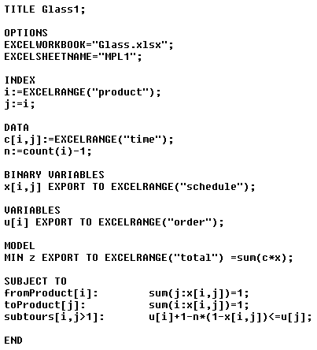
Transportation and Routing Problems
Treveling Salesman Problem in Production – optimal solution
The production batch always begins and ends with the production of a beaker.
Product | Beaker | Ashtray | Bottle | Bowl | Vase | Test tube
Beaker | 0 | 6 | 8 | 11 | 5 | 7
Ashtray | 4 | 0 | 2 | 7 | 4 | 7
Bottle | 5 | 12 | 0 | 10 | 7 | 6
Bowl | 4 | 7 | 5 | 0 | 7 | 10
Vase | 7 | 11 | 10 | 7 | 0 | 6
Test tube | 10 | 7 | 15 | 13 | 15 | 0
Product | Beaker | Ashtray | Bottle | Bowl | Vase | Test tube | Order
Beaker | 0 | 0 | 0 | 0 | 0 | 1 | 0.
Ashtray | 0 | 0 | 0 | 0 | 1 | 0 | 2.
Bottle | 1 | 0 | 0 | 0 | 0 | 0 | 5.
Bowl | 0 | 0 | 1 | 0 | 0 | 0 | 4.
Vase | 0 | 0 | 0 | 1 | 0 | 0 | 3.
Test tube | 0 | 1 | 0 | 0 | 0 | 0 | 1.
Objective value

Slide 122
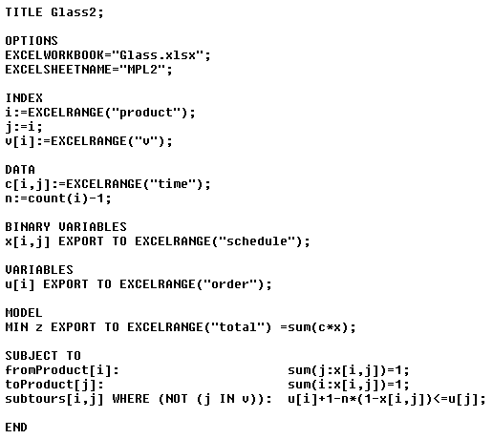
Transportation and Routing Problems
Treveling Salesman Problem in Production – optimal solution
The production batch begins with the production of the beaker and ends with any product.
Product | Beaker | Ashtray | Bottle | Bowl | Vase | Test tube
Beaker | 0 | 6 | 8 | 11 | 5 | 7
Ashtray | 0 | 0 | 2 | 7 | 4 | 7
Bottle | 0 | 12 | 0 | 10 | 7 | 6
Bowl | 0 | 7 | 5 | 0 | 7 | 10
Vase | 0 | 11 | 10 | 7 | 0 | 6
Test tube | 0 | 7 | 15 | 13 | 15 | 0
Product | Beaker | Ashtray | Bottle | Bowl | Vase | Test tube | Order
Beaker | 0 | 0 | 0 | 0 | 1 | 0 | 0
Ashtray | 0 | 0 | 1 | 0 | 0 | 0 | 3
Bottle | 0 | 0 | 0 | 0 | 0 | 1 | 4
Bowl | 0 | 1 | 0 | 0 | 0 | 0 | 2
Vase | 0 | 0 | 0 | 1 | 0 | 0 | 1
Test tube | 1 | 0 | 0 | 0 | 0 | 0 | 5
Objective value

Slide 123
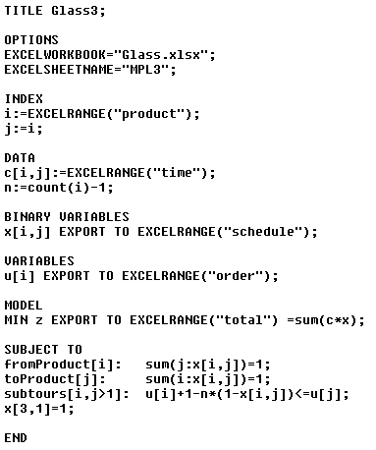
Transportation and Routing Problems
Treveling Salesman Problem in Production – solution
The production batch begins with the production of the beaker and ends with the production of the bottle.
Product | Beaker | Ashtray | Bottle | Bowl | Vase | Test tube
Beaker | 0 | 6 | 8 | 11 | 5 | 7
Ashtray | 0 | 0 | 2 | 7 | 4 | 7
Bottle | 0 | 12 | 0 | 10 | 7 | 6
Bowl | 0 | 7 | 5 | 0 | 7 | 10
Vase | 0 | 11 | 10 | 7 | 0 | 6
Test tube | 0 | 7 | 15 | 13 | 15 | 0
Product | Beaker | Ashtray | Bottle | Bowl | Vase | Test tube | Order
Beaker | 0 | 0 | 0 | 0 | 1 | 0 | 0.
Ashtray | 0 | 0 | 0 | 1 | 0 | 0 | 3.
Bottle | 1 | 0 | 0 | 0 | 0 | 0 | 5.
Bowl | 0 | 0 | 1 | 0 | 0 | 0 | 4.
Vase | 0 | 0 | 0 | 0 | 0 | 1 | 1.
Test tube | 0 | 1 | 0 | 0 | 0 | 0 | 2.
Objective value

Slide 124
Transportation and Routing Problems
Vehicle Routing Problem
Definition of the problem
G = {V, E} be a complete digraph with distance c_{ij} given for each arc (i, j).
Let node 1 be a depot, where one vehicle with capacity V is available, |U|= n.
Each customer i associated with request of size q_{i}.
The objective is to satisfy all customers’ requirements and to minimize total length of the routes.
Decision variables
Assumptions

Slide 125
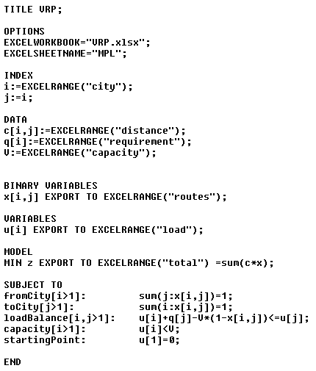
Transportation and Routing Problems
Vehicle Routing Problem – mathematical model
Model

Slide 126
Transportation and Routing Problems
Vehicle Routing Problem
Example
The sales representative of the brewery has arranged advantageous contracts.
Pubs will take barrels of beer in quantities given in the following table. For delivery, a vehicle with the capacity of 50 barrels will be used.
The objective is to satisfy all requirements minimizing total length of the vehicle tours.
 | Requirement
Velvary | 0
Kralupy | 18
Libcice | 10
Slany | 15
Zlonice | 12
Vrany | 10
Briza | 8
Veltrusy | 11

Slide 127
Transportation and Routing Problems
Vehicle Routing Problem – optimal solution
Optimal solution
Objective value
Route1 | Requirement
Velvary | 0
Kralupy | 18
Libcice | 10
Veltrusy | 11
Velvary | 0
Celkem | 39
Route1 | Requirement
Velvary | 0
Briza | 8
Vrany | 10
Zlonice | 12
Slany | 15
Velvary | 0
Celkem | 45

Slide 128
Transportation and Routing Problems
Pickup and Delivery Problems (PDP)
One-to-One PDP
For each requirement a pick-up location and a delivery location are given. Vehicle routes start and end at a common depot.
Transport of handicapped persons (Dial-a-Ride Problem), Messenger Problem etc.
Many-to-Many PDP
Commodity may be picked up at one of many locations and also be delivered to one of many locations.
For example, shared bicycles or scooters.
One-to-Many-to-One PDP
Each customer receives a delivery originating at a common depot and sends picked up quantity to the depot.
Barrels transport between brewery and restaurants etc.

Slide 129
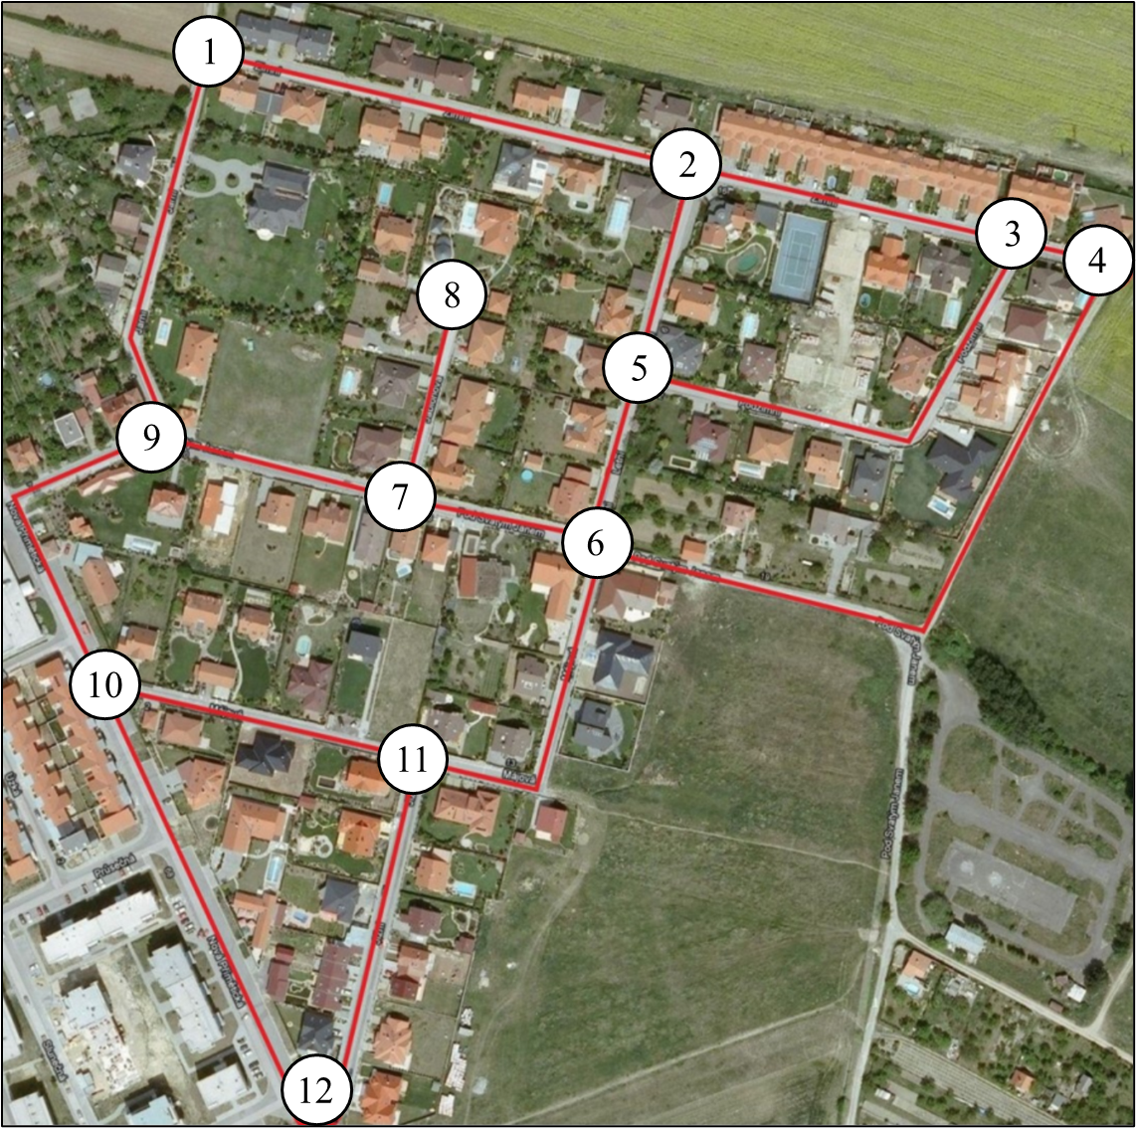
Transportation and Routing Problems
Undirected Chinese Postman Problem
Example
At Halloween, trik-or-treating children want to visit all houses in neighborhood. The lengths of streets (in meters), they must go through, are given in the table.
Will you plan a tour for children to minimize the total distance.
Arc | Length | Arc | Length
(1,2) | 210 | (6,7) | 80
(1,9) | 160 | (6,11) | 150
(2,3) | 140 | (7,8) | 80
(2,5) | 80 | (7,9) | 110
(3,4) | 40 | (9,10) | 160
(3,5) | 210 | (10,11) | 130
(4,6) | 310 | (10,12) | 190
(5,6) | 70 | (11,12) | 150

Slide 130
Transportation and Routing Problems
Undirected Chinese Postman Problem – mathematical model
Decision variables
Model

Slide 131
Transportation and Routing Problems
Undirected Chinese Postman Problem – optimal solution
Optimal solution
Objective value
Route: 1, 2, 3, 4, 6, 11, 12, 10, 9, 10, 11, 6, 5, 3, 2, 5, 6, 7, 8, 7, 9, 1.

Slide 132
Transportation and Routing Problems
Other Variations of Chinese Postman Problem
Directed Chinese Postman Problem (municipal waste collection in one-way streets)
Mixed Chinese Postman Problem (street clearing and sprinkling)
Capacitated Postman Problem (municipal waste collection)
Rural Postman Problem (mail delivery)
Windy Postman Problem (mail delivery)
Hierarchical Postman Problem (snow plowing)

Slide 133
Thank you for attention
Jan Fábry
Department of production, logistics and quality management
fabry@savs.cz www.janfabry.cz

